Slide 1
Juno
Jacqueline Garutti Lopes
jacqueline.garutti.lopes@usp.br
Notes:
Vídeo introdutório: https://youtu.be/TxtLYk-7aXM

Slide 2
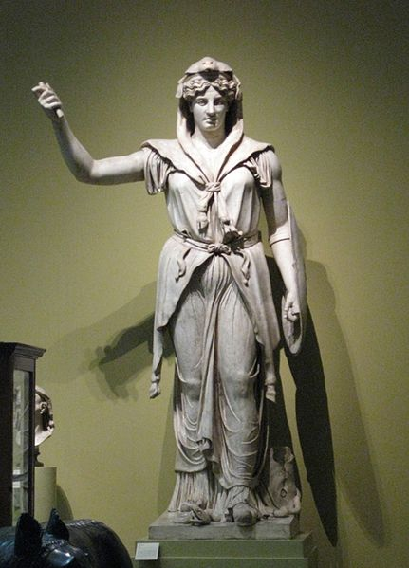
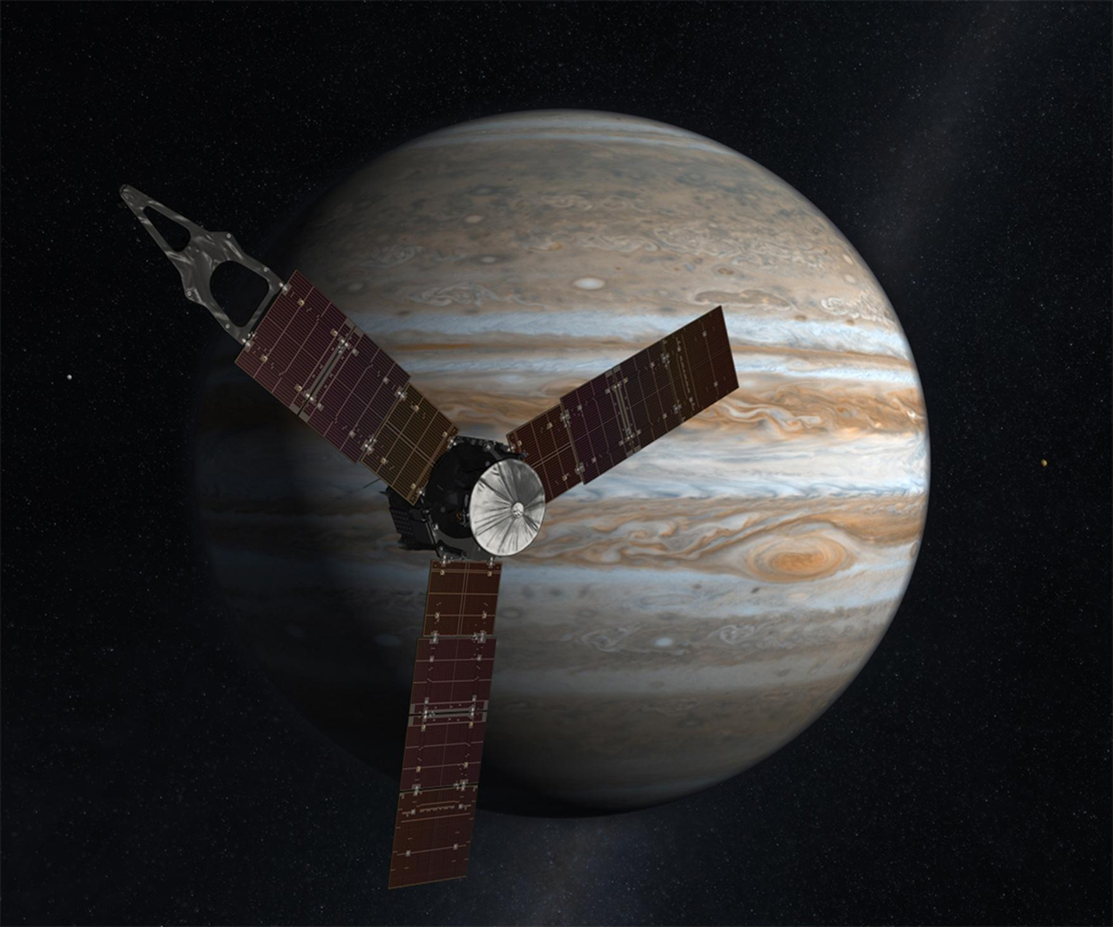
O que é Juno?

Slide 3
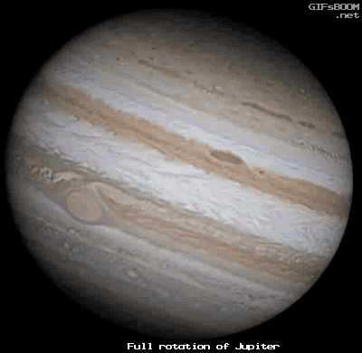
Por que Júpiter?

Slide 4
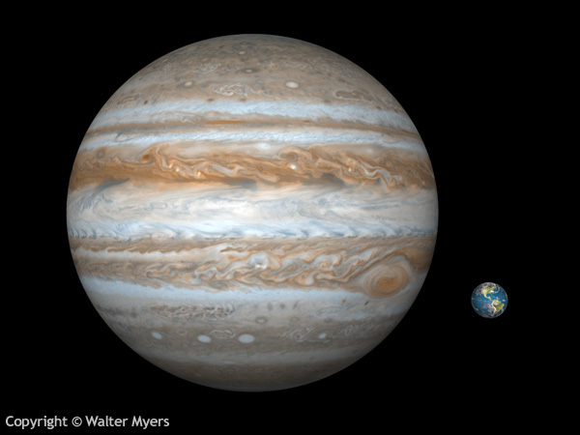

Slide 5
Alguns fatos sobre Júpiter:
Maior planeta
Maior planeta gasoso
Muitos exoplanetas são parecidos com Júpiter
1º a ser formado
Rotação de 10 horas
Atmosfera feita de Hélio e Hidrogênio
Tem 67(!) luas

Slide 6
O que não sabemos sobre Júpiter
Estrutura interna (Núcleo rochoso? Hidrogênio metálico?)
Há outros elementos que o formam?
O que dá origem ao campo magnético forte?
Como são os polos?
Como ele se originou?
Quando ele se originou?

Slide 7
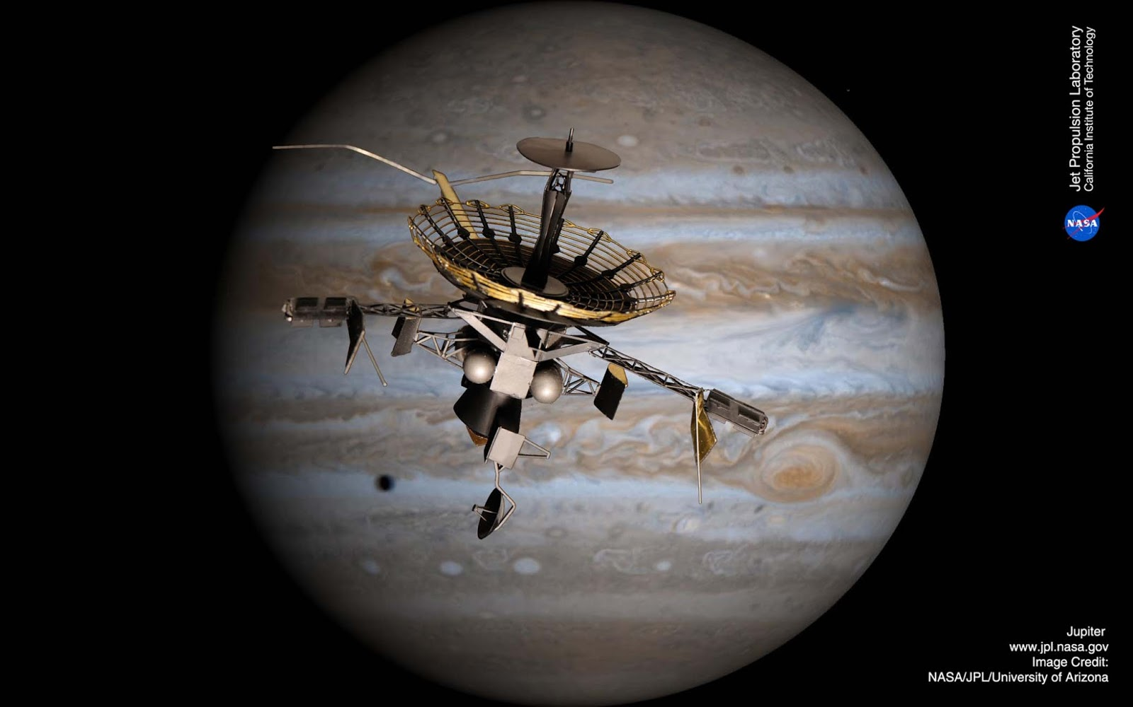
Galileo (1989-2003)

Slide 8
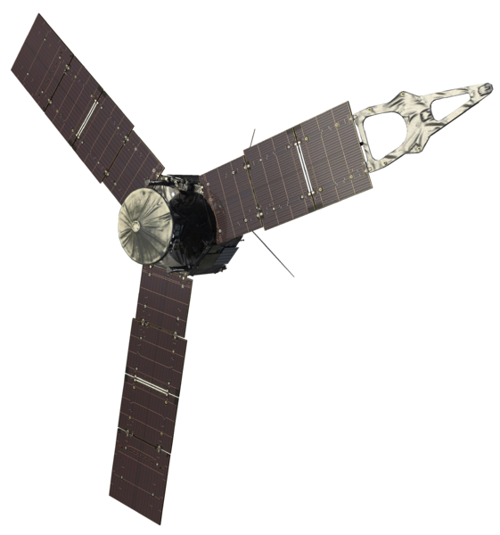
Juno

Slide 9
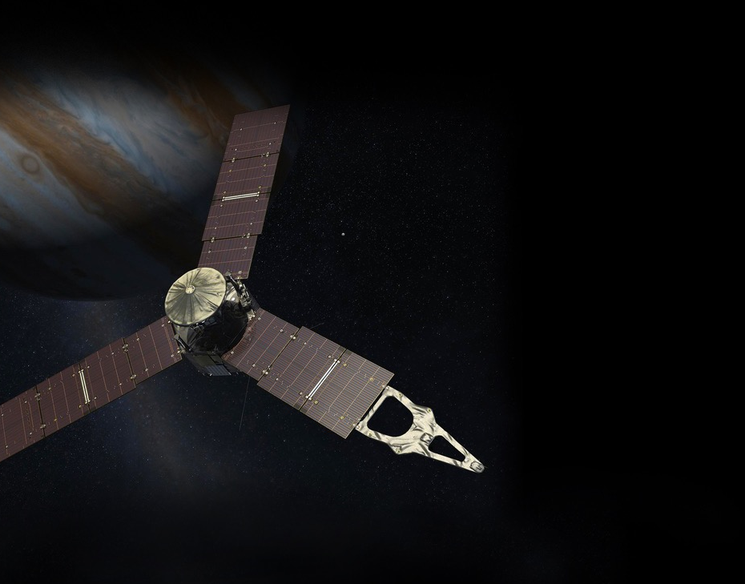
JunoCam
Ultraviolet
Spectrograph
(UVS)
Jovian Infrared
Auroral Mapper
(JIRAM)
Plasma Waves Instrument (WAVES)
Gravity Science
Instrumentos científicos da Juno
Jovian Auroral
Distributions
Experiment (JADE)
Microwave Radiometer (MWR)
Jupiter Energetic-particle
Detector Instrument (JEDI)
Magnetometer
Spacecraft Dimensions:
Diameter: 20 meters (66 feet)
Height: 4.5 meters (15 feet)

Slide 10
Instrumento/Função | Origem | Interior | Atmosfera | Magnetosfera
Gravity Science (GS) | • | • | •
Magnetometer (MAG) | • | • |  | •
Microwave Radiometer (MWR) | • | • | • | •
Jupiter Energetic Particle Detector (JEDI) |  |  |  | •
Jovian Auroral Distributions Experiment (JADE) |  |  |  | •
Plasma Waves Instrument (Waves) |  |  |  | •
Ultraviolet Spectrograph (UVS) |  |  |  | •
Jovian Infrared Auroral Mapper (JIRAM) |  |  | • | •
Visible Camera (JunoCam) |  |  | •

Slide 11
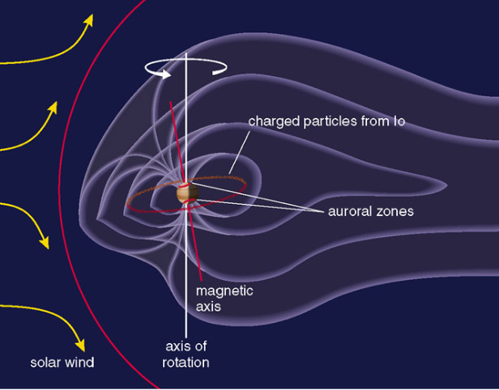
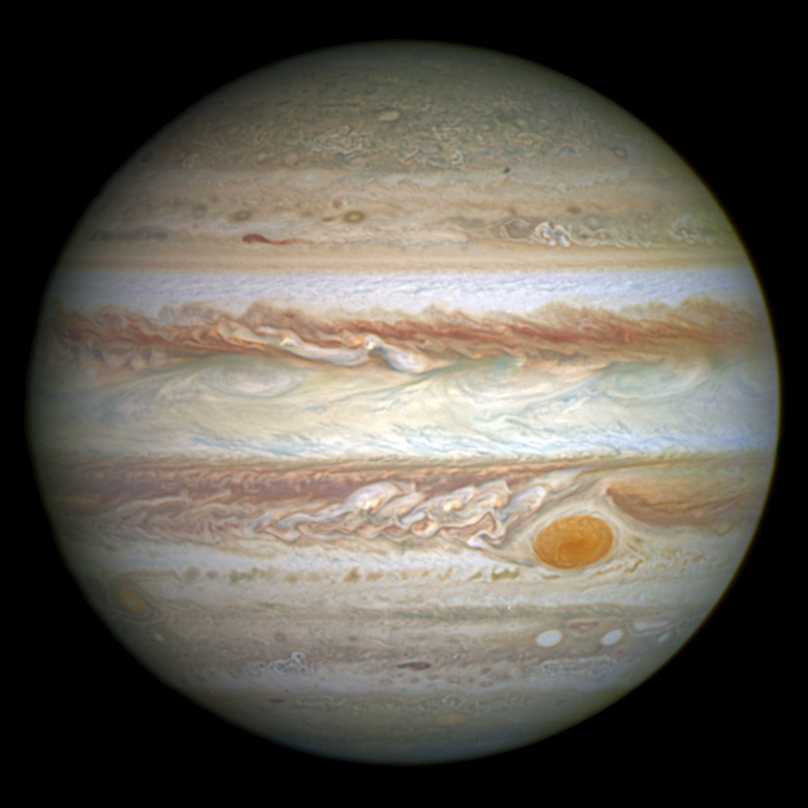
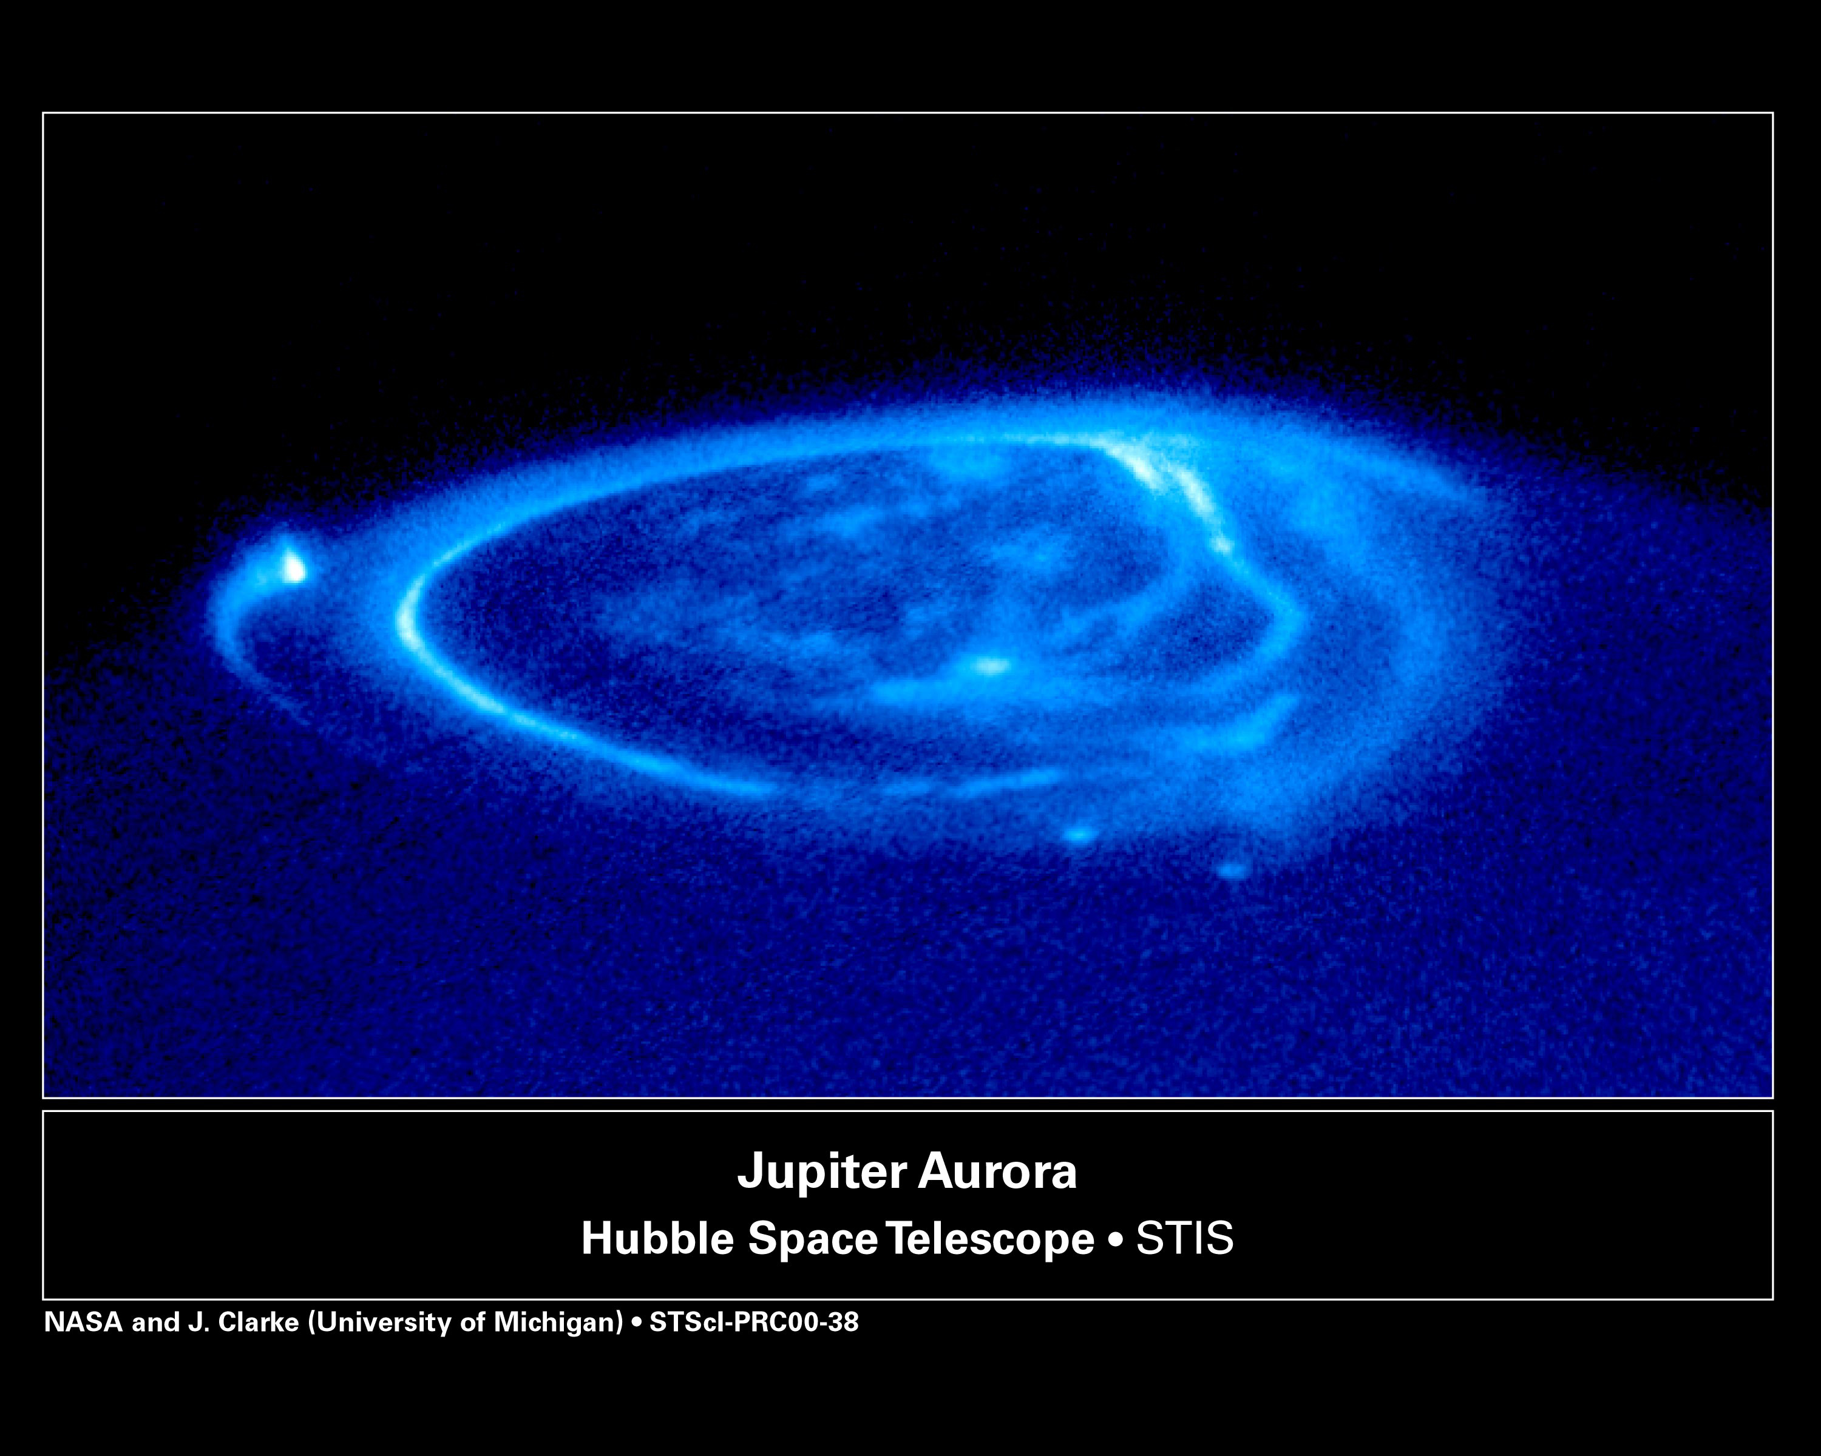

Slide 12
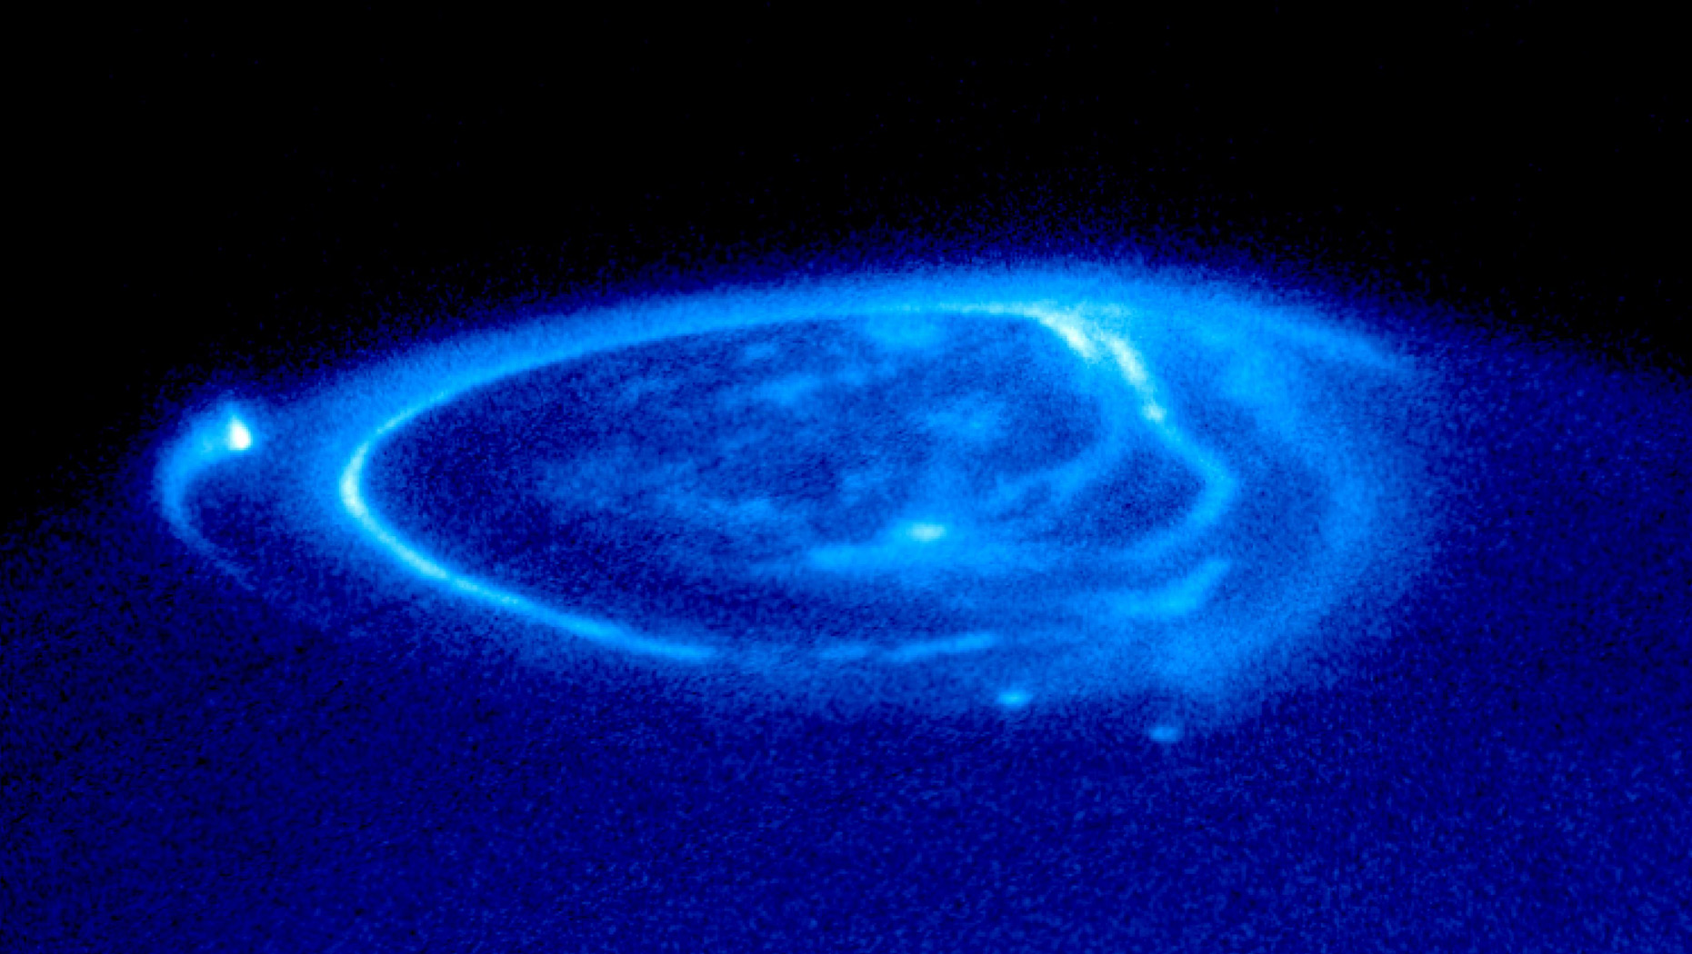
Magnetosfera Polar
Emissão Polar
Sombra de Io
Footprints of the magnetic field lines connecting the ionosphere with the moons.
Sombra de Ganymede e Europa F
Notes:
Jupiter’s magnetosphere near the planet’s poles is a completely unexplored region.
Juno’s investigation will provide new insights about how the planet’s enormous magnetic force field generates the aurora.
Aurora da terra: https://www.youtube.com/watch?v=HJfy8acFaOg

Slide 13
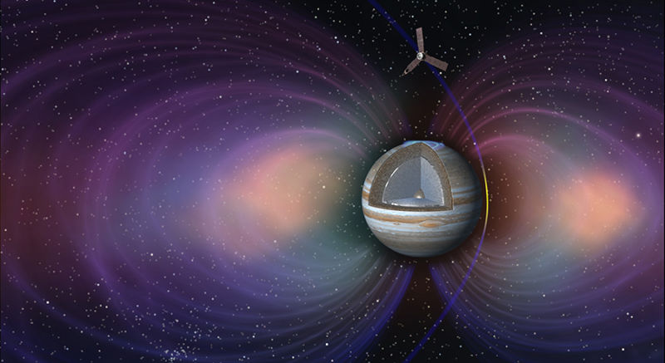

Slide 14
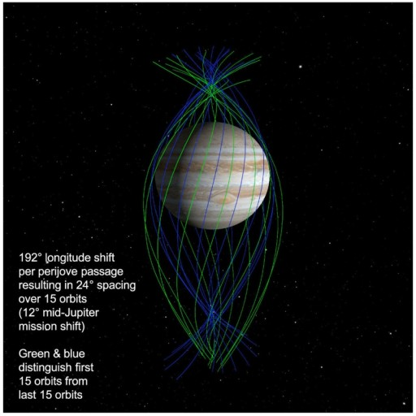
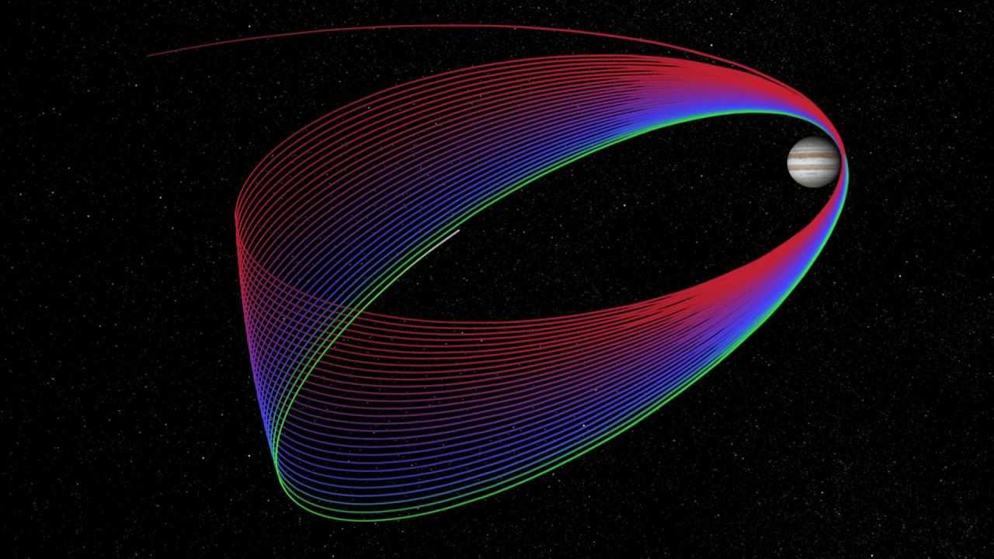
Órbita em Jupiter
Em cada aproximação, Juno vai chegar até 5 mil km perto das nuvens de Júpiter.
Notes:
Vídeo dos mapeamentos: https://www.youtube.com/watch?v=4J7St9Z9GBY e JOI: https://youtu.be/SgEsf4QcR0Q

Slide 15
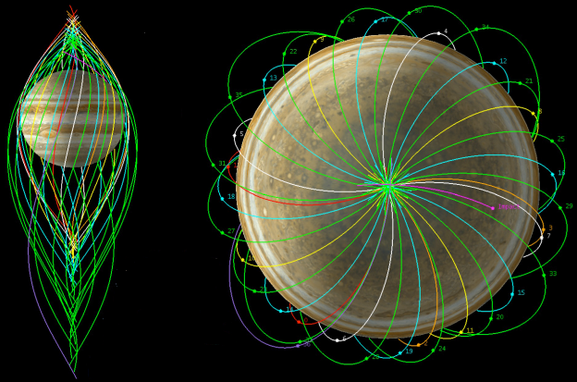
Campo Magnético
A órbita de Juno será de 2 semanas

Slide 16
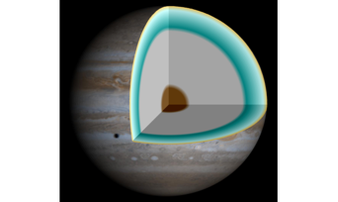
Temperatura de Jupiter
+1300 ºC (baixo) à 400 ºC (em cima )
10.273 ºC
35.000 ºC
Notes:
Juno will discern a temperature profile of the planet’s atmosphere.
Jupiter retains heat from its formation 4.5 billion years ago.
The planet is slowly cooling as heat is transported outwards.
The atmosphere cools predictably with altitude (like Earth).

Slide 17
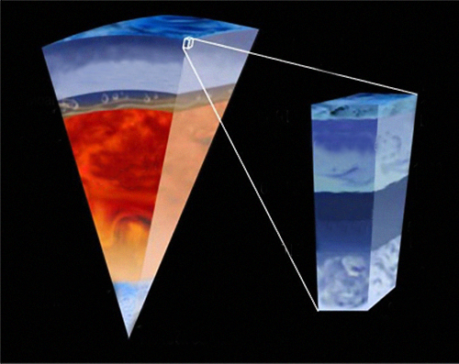
Mapeamento
Helium-poor
molecular hydrogen
Meteorological
Layer
1 bar
100 km
12
bars
2 Mbar
Convective
Region
Metallic
hydrogen?
1000
bars
600 km
Radiative
Zone?
5000
bars
1000 km
40 Mbar
Ice/rock core?
Notes:
Juno’s microwave radiometer experiment will map from the deepest interior to the atmosphere using microwaves, magnetic fields, and gravity fields.

Slide 18
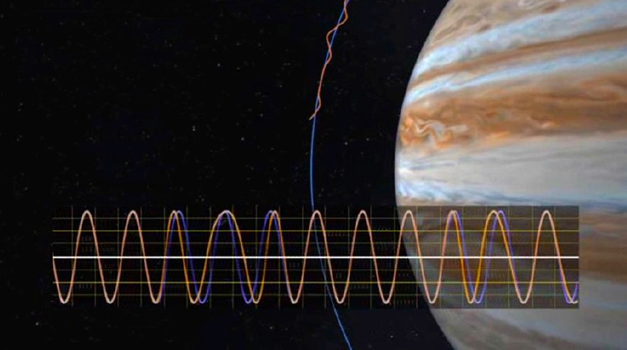
Gravitação de Jupiter
Computed Orbit
Gravity-Perturbed Orbit
TRANSMITTED SIGNAL
DOPPLER-SHIFTED SIGNAL
Notes:
Tracking changes in Juno’s velocity reveals Jupiter’s gravity and how the planet is arranged on the inside.
Precise Doppler measurements of spacecraft motion reveal the gravity field.
Tides in Jupiter caused by the moons may be detected and provide further clues.

Slide 19
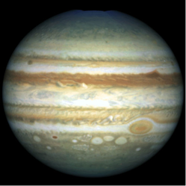
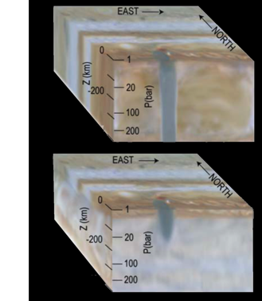
Estudo da Atmosfera
Notes:
Radiometry investigates atmospheric structure.
Gravity investigates differential rotation.

Slide 20
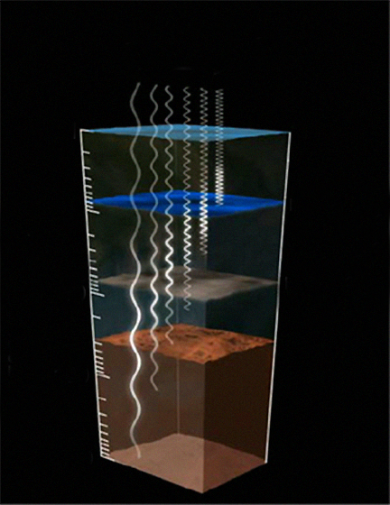
Estudo da Atmosfera
FREQUENCY
0.1
NH CLOUD
3
1
10
H O CLOUD
PRESSURE (BAR)
2
100
1000
Notes:
Juno measures thermal radiation from the atmosphere to as deep as 1000 atmospheres pressure (~500 to 600 km below the visible cloud tops).
Determines water and ammonia abundances in the atmosphere all over the planet.
Six microwave radiometer antennas measure Jupiter’s brightness at six different wavelengths.
Each antenna sees a different depth or range of depths.
Longer wavelengths of microwaves come from deeper down.

Slide 21
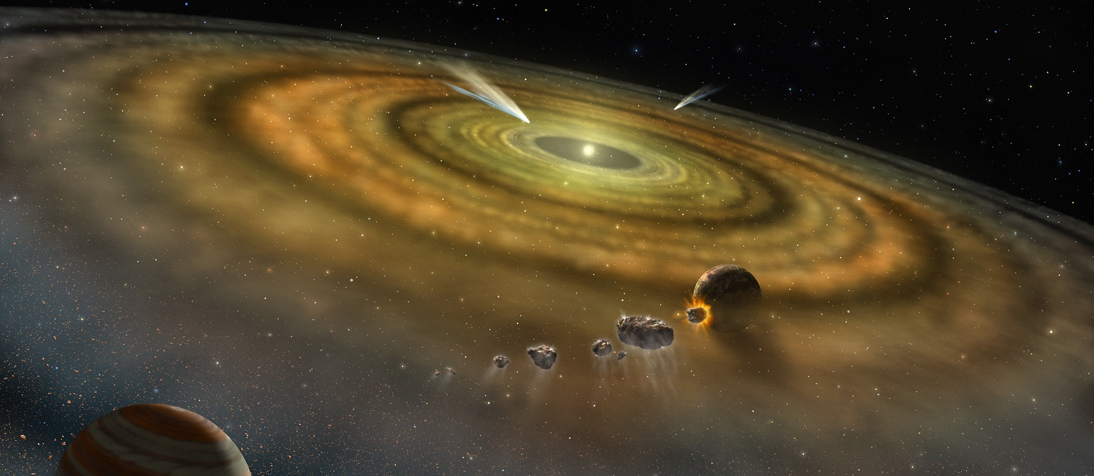
Origem de Júpiter
Notes:
Jupiter might have formed from the collision of many asteroid-sized pieces of water ice — icy planetesimals.
Jupiter’s water content will tell us whether or not Jupiter formed farther from the Sun and drifted into its current location.
If Juno does not find a lot of water in Jupiter, the icy planetesimal theory is wrong and we need a whole new way to understand Jupiter’s formation.

Slide 22
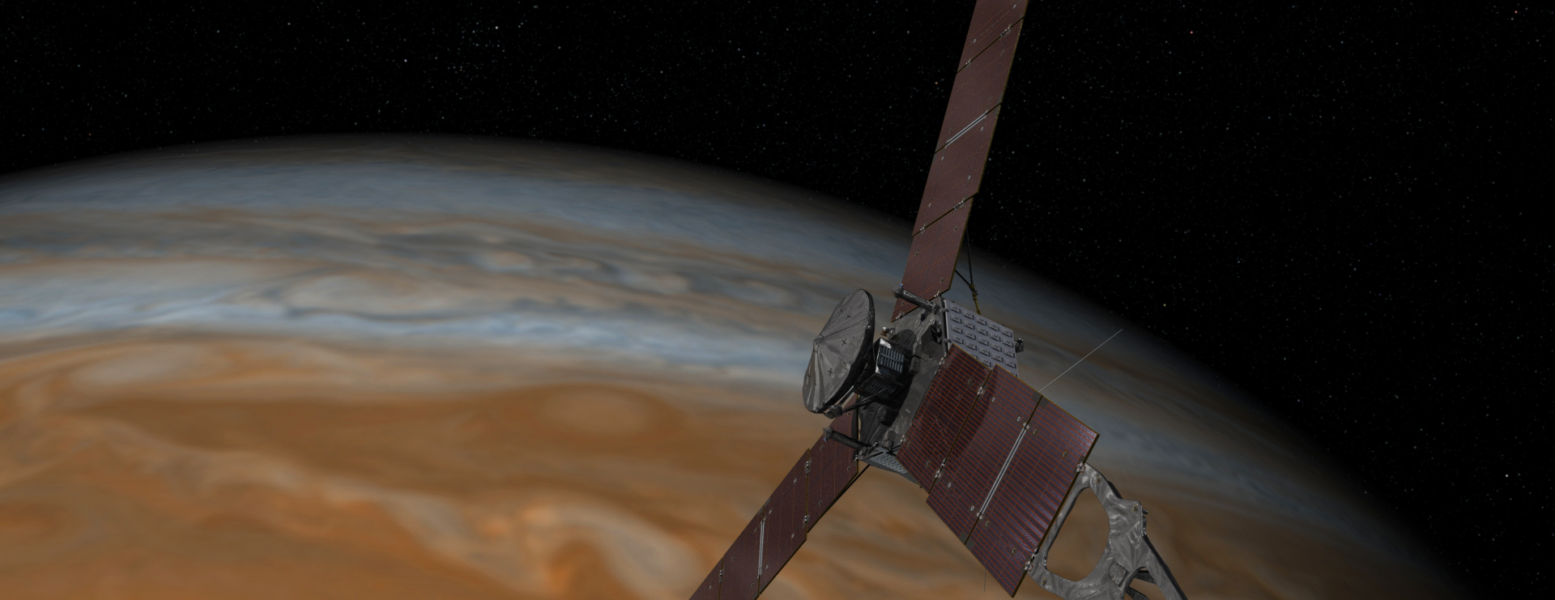
Fim da missão
Fevereiro de 2018, Juno vai entrar em Júpiter
Ao fim, Juno vai receber radiação equivalente a 100 milhões de Raios-X
Por causa da radiação, Juno ficará danificada e por isso adentrará em Júpiter

Slide 23
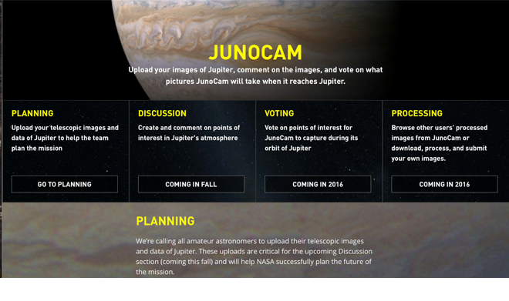
Como participar
“Science in a Fishbowl”
http://missionjuno.swri.edu — click on “Junocam”

Slide 24
Acompanhe a Juno

Slide 25
Referências:
Nasa (https://www.nasa.gov/mission_pages/juno/)
Site da Juno (https://www.missionjuno.swri.edu/)
http://spaceflight101.com/juno/juno-mission-trajectory-design/
https://www.nasa.gov/mission_pages/juno/multimedia/junoppt.html#.V3CgbbgrK00
http://spaceflight101.com/juno/spacecraft-information/
http://www.popsci.com/how-juno-spacecraft-will-survive-jupiters-devastating-radiation

Slide 26
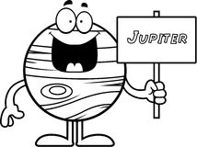
Obrigada!!!

