Slide 1


Luz, câmera
Astronomia!
Jennifer Machado Soares
jennifer.soares@usp.br

Slide 2
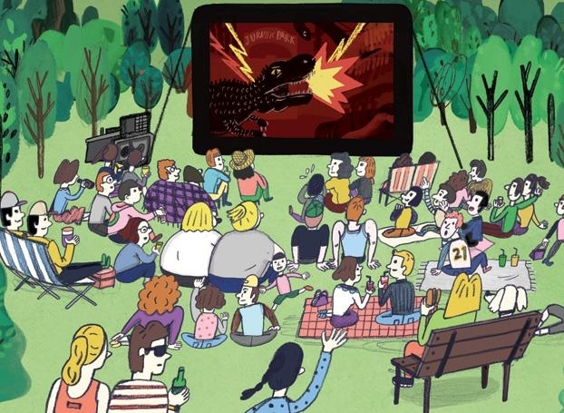
Notes:
http://www.wweek.com/portland/imgs/media.images/23877/movies_moviesinthepark_hyunyoungkim.widea.jpg

Slide 3


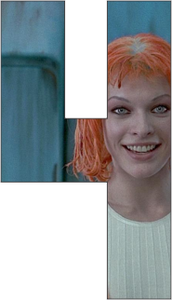
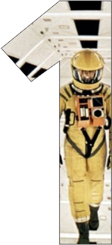
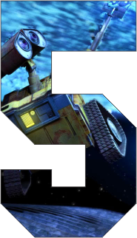




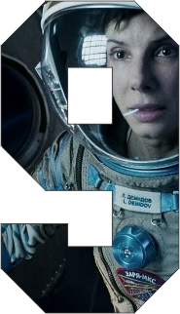
Notes:
http://www.quadroporquadro.com.br/2015/07/no-dia-da-1-viagem-lua-10-filmes_20.html

Slide 4
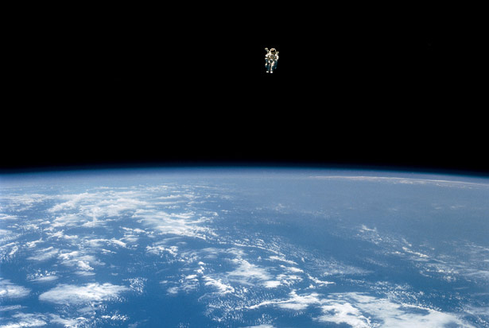
Estamos sós no universo?

Slide 5
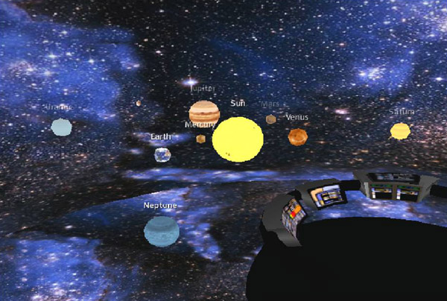

Notes:
http://www.ussventure.eng.br/LCARS-Terminal_net_arquivos/nave/sistemas.htm

Slide 6
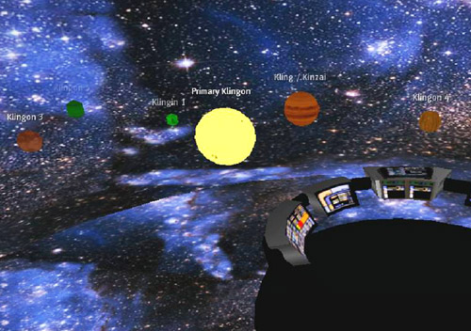
SISTEMA KLINGON

Slide 7
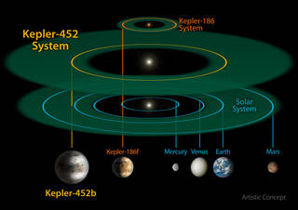
Notes:
https://www.nasa.gov/press-release/nasa-kepler-mission-discovers-bigger-older-cousin-to-earth

Slide 8
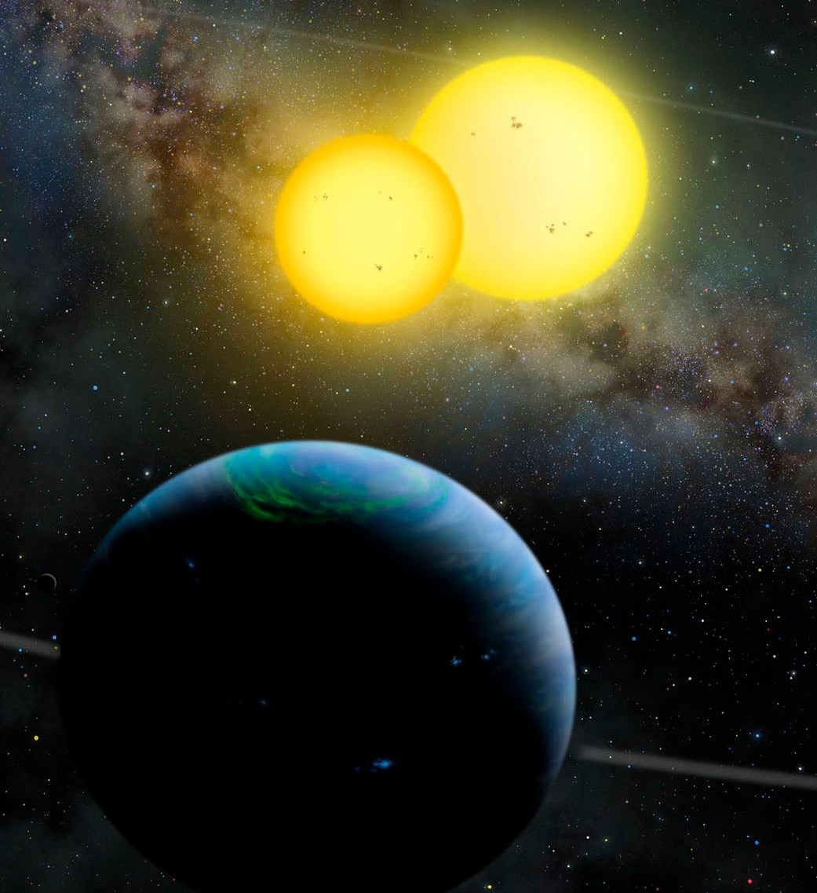
Kepler-35b
Notes:
https://www.nasa.gov/mission_pages/kepler/multimedia/images/kepler-35-artist-concept-1.html

Slide 9
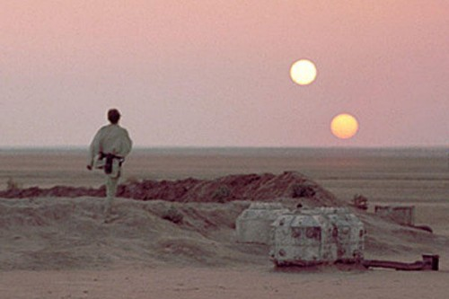


Slide 10
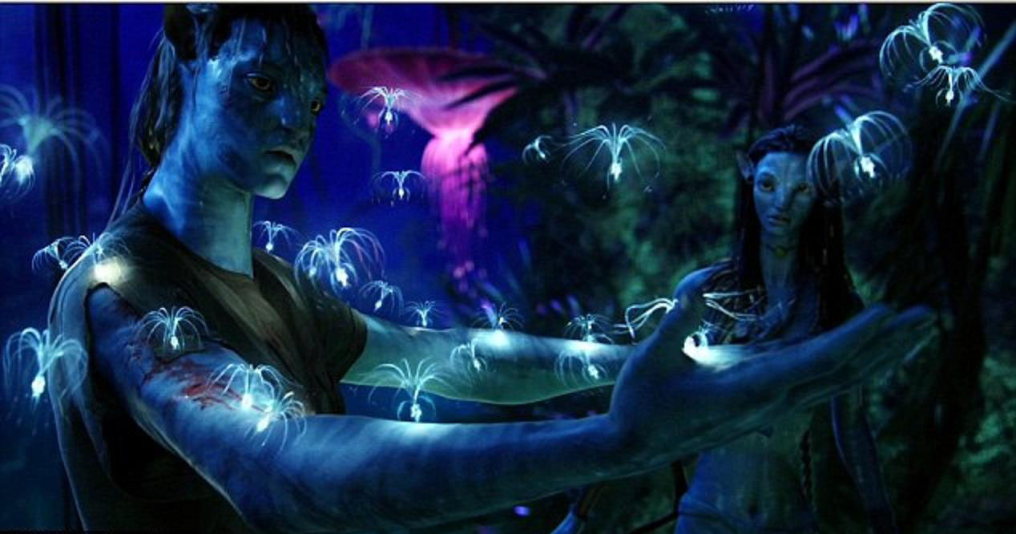

Notes:
https://maaretta.files.wordpress.com/2010/12/avatar1c1.jpg

Slide 11

Notes:
http://www.wikinoticia.com/images/www.ecologismo.com/www.ecologismo.com.wp-content.uploads.2010.07.Biodiversidad-300x200.jpg

Slide 12
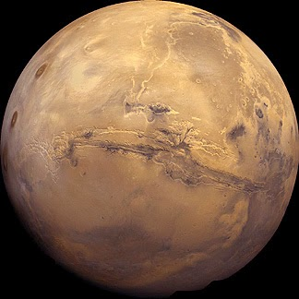
Notes:
http://1.bp.blogspot.com/-tngOvSeXG5Y/VJHU3NzOkZI/AAAAAAAAtS8/U_SnS_DSJLA/s1600/mars%2Bmarte.jpg

Slide 13
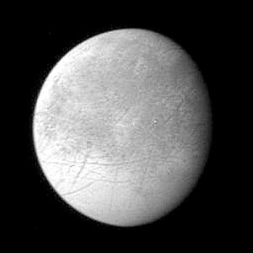
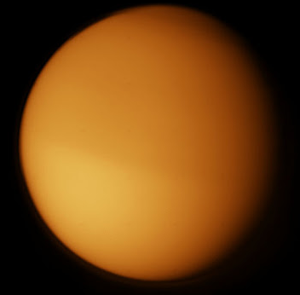

Slide 14
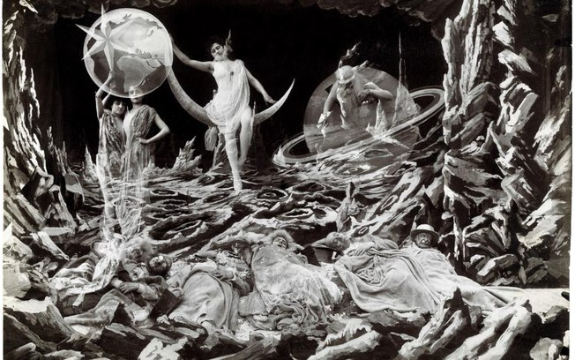
Viagem a Lua
Notes:
http://i0.statig.com.br/bancodeimagens/57/k0/u8/57k0u8fpdxftitfndifzwf34r.jpg

Slide 15

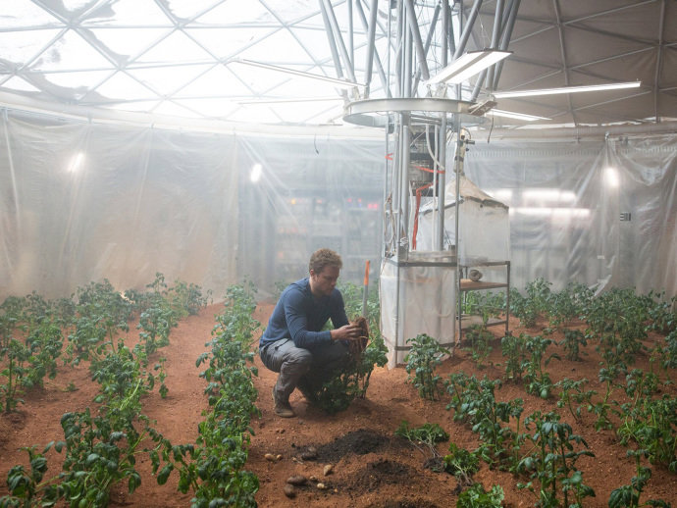
Notes:
http://veja.abril.com.br/noticia/ciencia/a-ventania-marciana-e-outros-erros-e-acertos-cientificos-de-perdido-em-marte

Slide 16

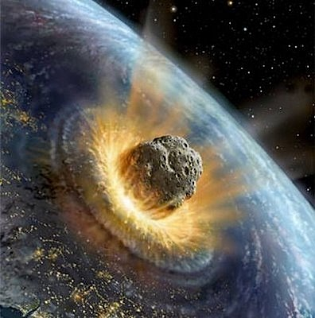
Notes:
https://blogdoastronomo.wordpress.com/2012/03/17/armageddon/

Slide 17
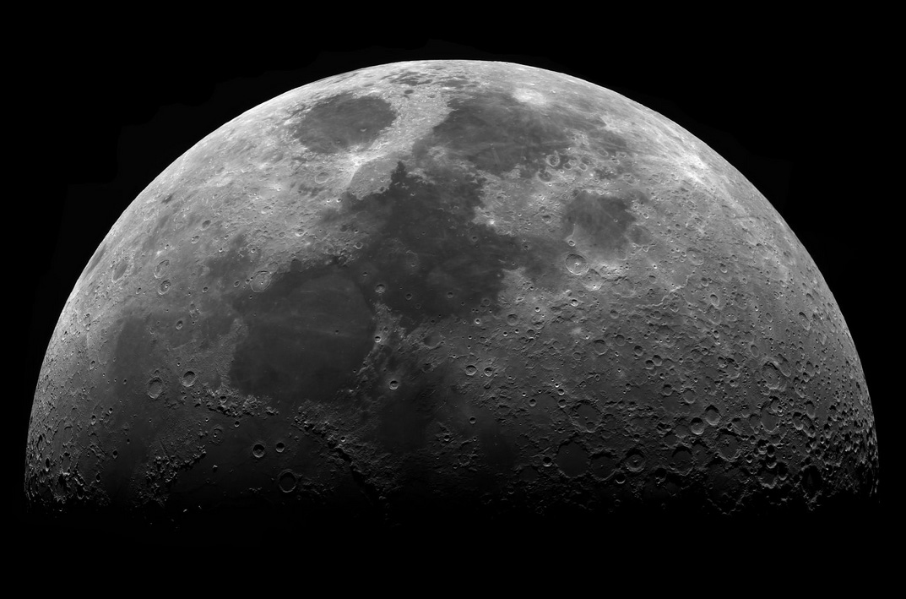
Notes:
http://oasa.centrosciencia.azores.gov.pt/sites/default/files/zoomintothemoon.jpg

Slide 18
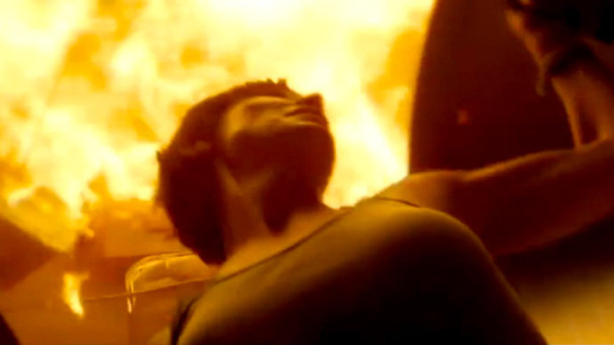


Slide 19
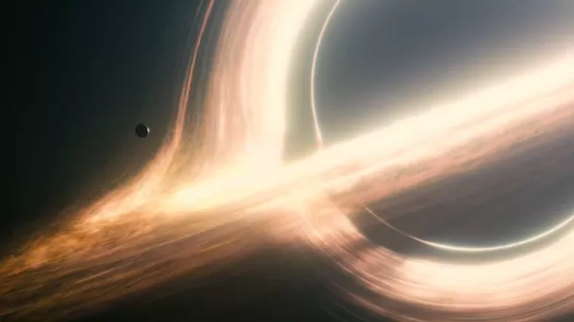

Notes:
http://syfy.globo.com/programas/radar-syfy/materias/conheca-a-ciencia-por-tras-do-filme-interestelar.html

Slide 20
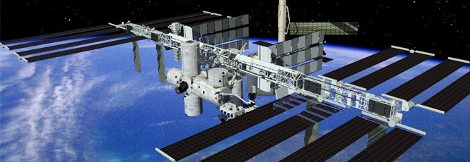
Notes:
http://imagens.canaltech.com.br/2477.4505-Estacao-Espacial-Internacional.jpg

Slide 21

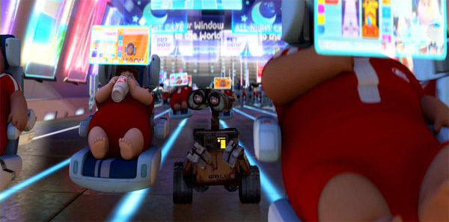
Notes:
http://www.saudeamesa.com.br/wp-content/uploads/2013/06/walle.jpg

Slide 22

Notes:
http://d38zt8ehae1tnt.cloudfront.net/images/news/700_415cdeb5f4d44dc30786f9704bcdc549.jpg

