Slide 1
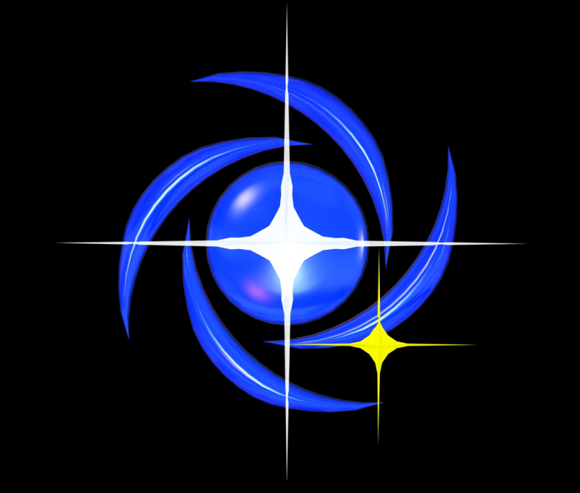
Centro de Divulgação da Astronomia
Observatório Dietrich Schiel

Slide 2
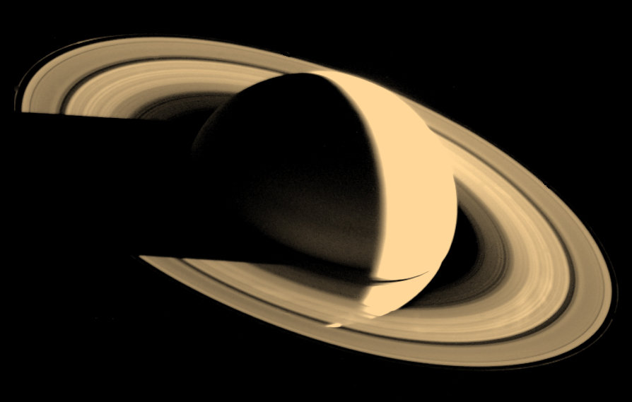
Saturno
Notes:
Saturn's Shadow Date: 16 Nov 1980
Voyager 1 looked back at Saturn on Nov. 16, 1980, four days after the spacecraft flew past the planet, to observe the appearance of Saturn and its rings from this unique perspective. A few of the spoke-like ring features discovered by Voyager appear in the rings as bright patches in this image, taken at a distance of 5.3 million km (3.3 million miles) from the planet. Saturn's shadow falls upon the rings and the bright Saturn crescent is seen through all but the densest portion of the rings.
Credit: NASA

Slide 3
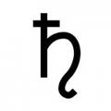
Saturno
Deus romano da agricultura
Notes:
Saturno, gravura do século XVI deCaravaggio.
http://pt.wikipedia.org/wiki/Saturno_(mitologia)

Slide 4
Planetas do nosso sistema solar
Marte
Vênus
Terra
Urano
Netuno
Mercúrio
Júpiter
Saturno
Notes:
Apresentação e comparação de tamanho entre os planetas do sistema solar
Jupter, sexto planeta do sistema solar e o segundo maior
Imagem:
All Planet Sizes
This illustration shows the approximate sizes of the planets relative to each other. Outward from the Sun, the planets are Mercury, Venus, Earth, Mars, Jupiter, Saturn, Uranus, and Neptune, followed by the dwarf planet Pluto. Jupiter's diameter is about 11 times that of the Earth's and the Sun's diameter is about 10 times Jupiter's. Pluto's diameter is slightly less than one-fifth of Earth's. The planets are not shown at the appropriate distance from the Sun.
Credit: Lunar and Planetary Institute

Slide 5
Planetas do nosso sistema solar
Terra
Diâmetro da Terra:
12 742 km
Saturno
Proporção:
9,14 x Terra!
Diâmetro de Saturno:
116 464 Km
Notes:
Apresentação e comparação de tamanho entre os planetas do sistema solar
Imagem:
All Planet Sizes
This illustration shows the approximate sizes of the planets relative to each other. Outward from the Sun, the planets are Mercury, Venus, Earth, Mars, Jupiter, Saturn, Uranus, and Neptune, followed by the dwarf planet Pluto. Jupiter's diameter is about 11 times that of the Earth's and the Sun's diameter is about 10 times Jupiter's. Pluto's diameter is slightly less than one-fifth of Earth's. The planets are not shown at the appropriate distance from the Sun.
Credit: Lunar and Planetary Institute

Slide 6
Orbita dos planetas visíveis
~1 430 000 000 km
Revolução:
29,5 ano
~150 000 000 km
Revolução:
1 ano
Notes:
Orbita da Terra: 149,598,262 km
Orbita de Saturno: 1,426,666,422 km
Visible Planet Orbits
This diagram shows the relative size of the orbits of the seven planets visible to the naked eye. All the orbits are nearly circular (but slightly elliptical) and nearly in the same plane as Earth's orbit (called the ecliptic). The diagram is from a view out of the ecliptic plane and away from the perpendicular axis that goes through the Sun. Image Credit: Lunar and Planetary Institue
Credit: Lunar and Planetary Institute

Slide 7
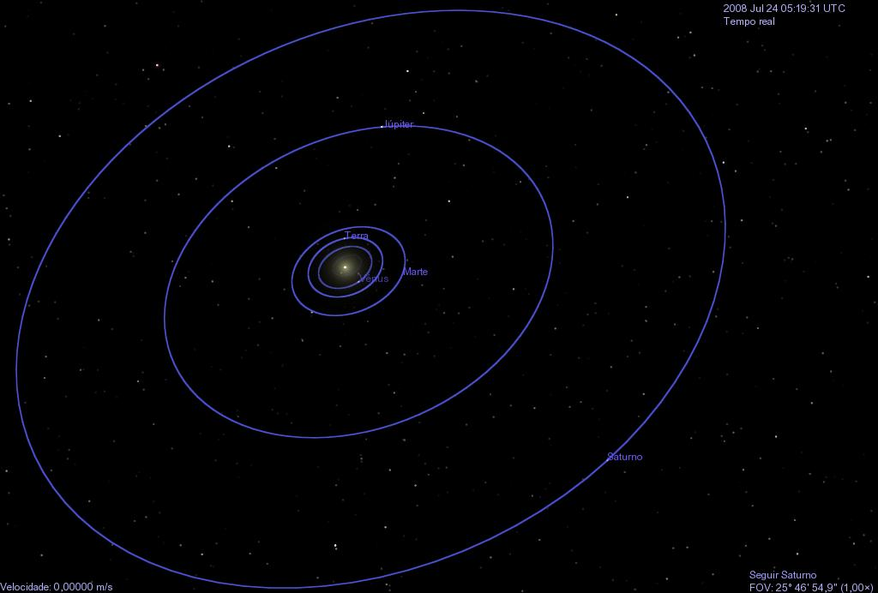
Distância à Saturno
Júpiter
Terra
Sol
1 UA
8,5 UA
29,5 anos
1 UA = 150 000 000 Km
9,6 Km/s
SSaturno = 1 270 000 000 Km
Saturno
Notes:
Velocidade da Luz: c = 299.792.458 m/s
Para vir do Sol à Terra a luz demora 8,3 minutos;
Para ir da Terra à Saturno ela demora 1,17 horas;
Em 1 segundo a luz dá 7 voltas na Terra (Raio ~ 6.300 Km)
Velocidade orbital média da Terra: 29,7 Km/s
7

Slide 8
Características
Volume: 763,594 x Terra
Massa: 95,161 x Terra
Densidade: 0,687 g/cm³
Densidade da água: 1,0 g/cm³
Notes:
The Cassini spacecraft takes an angled view toward Saturn, showing the southern reaches of the planet with the rings on a dramatic diagonal.
The moon Enceladus (313 miles, or 504 kilometers across) appears as a small, bright speck in the lower left of the image.
Image credit: NASA/JPL-Caltech/Space Science Institute

Slide 9
Características
Temperatura na superfície: -178 °C
Gravidade na superfície: 10.4 m/s²
Composição da atmosfera:
Hidrogênio e Helio
Notes:
Uma pessoa de 600N pesaria 640N na Superfície de Saturno
Rings and Shadows Date: 10 May 2004
Saturn's rings cast threadlike shadows on the planet's northern hemisphere. Note the translucent C ring, and thin outermost F ring. The image was taken with the Cassini narrow angle camera in visible light on May 10, 2004, at a distance of 27.2 million kilometers (16.9 million miles) from Saturn. Image scale is 162 kilometers (101 miles) per pixel. Contrast in the image was enhanced to aid visibility. Image Credit: NASA/JPL/Space Science Institute
Credit: NASA Planetary Photojournal

Slide 10
Anéis
10 000 anéis!
1 Km espessura!
~ 67 000 Km
Notes:
Esta imagem foi possível graças a oposição da sonda com o Sol, tornando visível anéis ainda mais externo
Em torno de 67 000 Km de extensão, mas somente 1km de espessura
Anéis completos de Saturno: Mais de 10 000 anéis!
Cassini spacecraft in 2006
CREDIT: Cassini Imaging Team, SSI, JPL, ESA, NASA

Slide 11
Anéis
Notes:
O ponto que aparece em destaque neste slide se trata do planeta Terra
Anéis completos de Saturno: Mais de 10 000 anéis!
Cassini spacecraft in 2006
CREDIT: Cassini Imaging Team, SSI, JPL, ESA, NASA

Slide 12
Divisões dos anéis
F
D
C
B
A
Notes:
http://saturn.jpl.nasa.gov/science/?sciencepageid=55

Slide 13
Divisões dos anéis
Divisão Cassini
Divisão de Roche
Notes:
http://saturn.jpl.nasa.gov/science/?sciencepageid=55

Slide 14
Olhando os anéis de perto
Notes:
Ring Close-up
This image shows a close-up view of a density wave in Saturn's A ring. It was taken by the narrow angle camera on the Cassini spacecraft after successful entry into Saturn's orbit. The view shows the dark, or unlit, side of the rings. Image Credit: NASA/JPL/Space Science Institute
Credit: Jet Propulsion Laboratory

Slide 15
Composição dos anéis
Notes:
Imagem por William Hartmann
http://ircamera.as.arizona.edu/NatSci102/NatSci102/lectures/moonsandrings.htm

Slide 16
Formação dos anéis
Notes:
Saturn Ring Formation
"This piece is an illustration of a theory of Saturn ring formation that was published inNature and written by Robin Canup. A large Titan-sized moon made of ice and silicate enters Saturn's Roche limit and is torn apart. The silicate core is consumed by Saturn, but the ice remains, eventually forming the beautiful rings we see today. This is a 3D image that went through several iterations. Carolyn Porco was instrumental in providing the technical data that was needed to produce the final piece." Greg Prichard © 2011
http://www.canvassoldier.com/Canvas_Soldier/Canvas_Soldier_Home.html

Slide 17
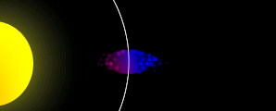
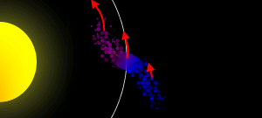
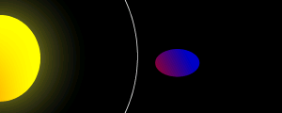
Formação dos anéis
Notes:
Saturn Ring Formation
"This piece is an illustration of a theory of Saturn ring formation that was published inNature and written by Robin Canup. A large Titan-sized moon made of ice and silicate enters Saturn's Roche limit and is torn apart. The silicate core is consumed by Saturn, but the ice remains, eventually forming the beautiful rings we see today. This is a 3D image that went through several iterations. Carolyn Porco was instrumental in providing the technical data that was needed to produce the final piece." Greg Prichard © 2011
http://www.canvassoldier.com/Canvas_Soldier/Canvas_Soldier_Home.html

Slide 18
Pólo Norte

Slide 19
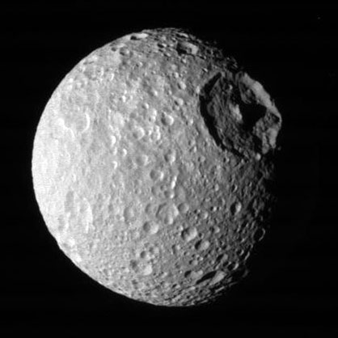
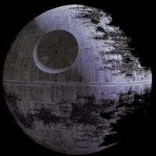
Pólo Norte
Mimas
Notes:
http://saturn.jpl.nasa.gov/photos/imagedetails/index.cfm?imageId=4762
Mimas Peeks Over Saturn March 18, 2013Full-Res: PIA14652 Saturn and its north polar hexagon dwarf Mimas as the moon peeks over the planet's limb. Saturn's A ring also makes an appearance on the far right. Mimas is 246 miles (396 kilometers) across.This view looks toward the sunlit side of the rings from about 21 degrees above the ringplane. The image was taken with the Cassini spacecraft wide-angle camera on Nov. 28, 2012 using a spectral filter sensitive to wavelengths of near-infrared light centered at 752 nanometers.
The view was obtained at a distance of approximately 495,000 miles (797,000 kilometers) from Saturn and at a Sun-Saturn-spacecraft, or phase, angle of 4 degrees. Image scale is 27 miles (44 kilometers) per pixel.
The Cassini-Huygens mission is a cooperative project of NASA, the European Space Agency and the Italian Space Agency. The Jet Propulsion Laboratory, a division of the California Institute of Technology in Pasadena, manages the mission for NASA's Science Mission Directorate in Washington. The Cassini orbiter and its two onboard cameras were designed, developed and assembled at JPL. The imaging team is based at the Space Science Institute, Boulder, Colo.
For more information about the Cassini-Huygens mission visit http://saturn.jpl.nasa.gov or http://www.nasa.gov/cassini . The Cassini imaging team homepage is at http://ciclops.org .
Credit: NASA/JPL-Caltech/Space Science Institute
Death star:http://starwars.wikia.com/wiki/Death_Star?file=DeathStar2.jpg

Slide 20
Pólo sul
Notes:
http://apod.nasa.gov/apod/ap081027.html

Slide 21
Pólo sul
Notes:
http://saturn.jpl.nasa.gov/photos/imagedetails/?imageID=3268

Slide 22
Pólo sul

Slide 23
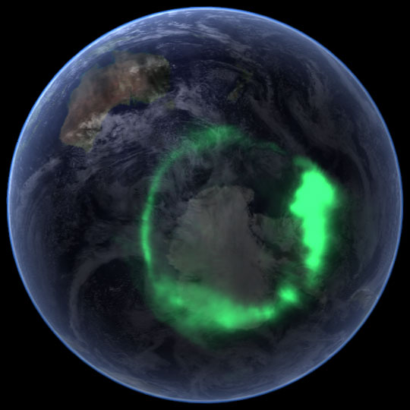
Auroras
Notes:
Assim como ocorre na Terra as auroras também podem surgir nos polos do planeta gasoso
Saturn's Auroras Date: 28 Jan 2005
These images of Saturn's polar aurora were taken by NASA's Hubble Space Telescope on Jan. 24, 26, and 28. Each of the three images of Saturn combines ultraviolet images of the south polar region (to show the auroral emissions) with visible wavelength images of the planet and rings. The Hubble images were obtained during a joint campaign with NASA's Cassini spacecraft to measure the solar wind approaching Saturn and the Saturn kilometric radio emissions. The strong brightening of the aurora on January 26 corresponded with the recent arrival of a large disturbance in the solar wind. These results are presented in three papers, which appear in the Feb. 17 issue of the journal Nature. Credit: NASA/Hubble/Z. Levay and J. Clarke
Credit: HubbleSite

Slide 24
Luas de Saturno
Total de 62 luas!
Notes:
http://www.astroarts.org/content/galleries/cassini/satsystem.jpg

Slide 25
Luas de Saturno

Slide 26
Luas de Saturno
Notes:
Imagem: http://en.wikipedia.org/wiki/File:Saturn%27s_Rings_PIA03550.jpg

Slide 28
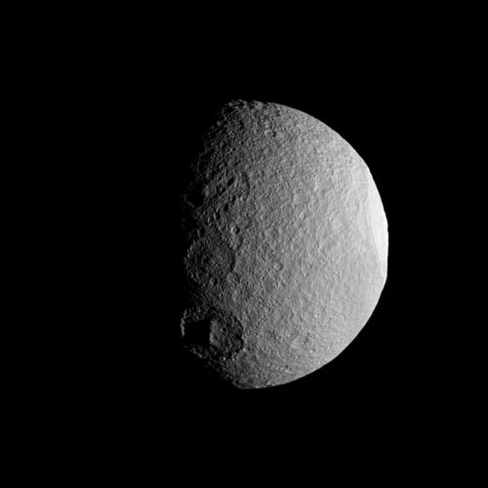
Tétis
Titã
Notes:
Tethys and Titan Date: 26 Nov 2009
Saturn's moon Tethys with its prominent Odysseus Crater silently slips behind Saturn's largest moon Titan. Tethys is not actually enshrouded in Titan's atmosphere. Tethys (1,062 km, or 660 miles across) is more than twice as far from Cassini than Titan (5,150 km, or 3,200 miles across) in this sequence. Tethys is 2.2 million km (1.4 million miles) from Cassini. Titan is about 1 million km (621,000 miles) away. Last Update: 30 Mar 2011 (AMB)
Credit: NASA/JPL/Space Science Institute

Slide 29
3 474 km
5 150 km
12 742 km
Notes:
Imagem retirada de:
http://www.arcadiastreet.com/cgvistas/saturn_4200.htm

Slide 30
Titã

Slide 31
Titã
Notes:
http://terraform.no.sapo.pt/Menu_Principal/Saturno/Anomalias_em_Saturno4.htm

Slide 32
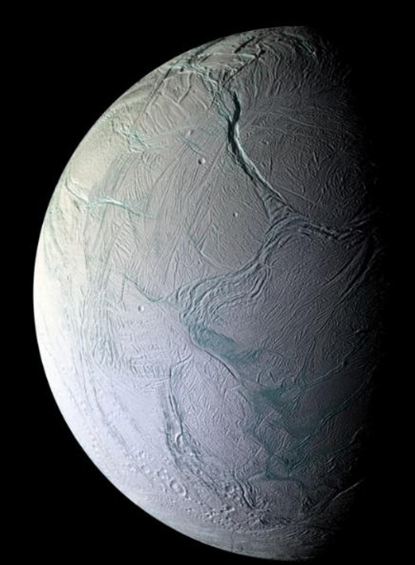
Enceladus
Notes:
Planeta gelado

Slide 33
Enceladus
Notes:
Planeta gelado

Slide 34
Oposição de Saturno
Notes:
http://saturn.jpl.nasa.gov/education/saturnobservation/viewingsaturn/

Slide 35
Notes:
The Saturn views were simulated with a computer program written by Tom Ruen. (Created here for public domain)
Reference:
Book: "Astronomical Formulae for Calculators, 4th edition", Jean Meeus, 1988, published by "Willmann-Bell, Inc"

Slide 36
Obliquidade do planeta

Slide 37
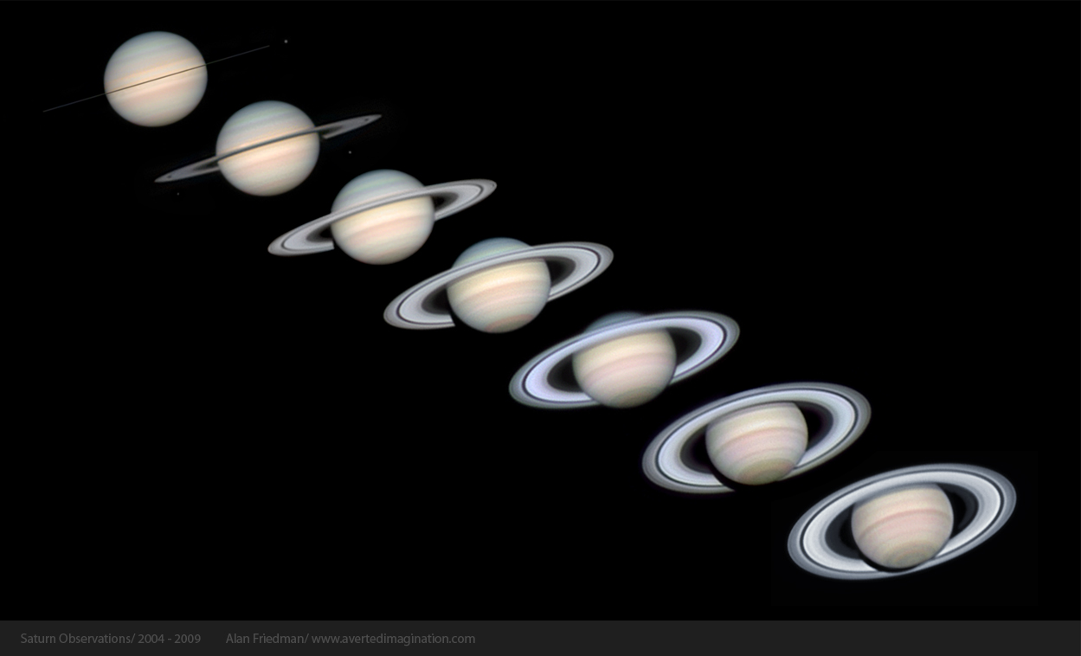
Obliquidade do planeta
Notes:
Imagem retirada do livro: Planet observer handbook, Price

Slide 39
Perguntas?
?

Slide 40
Fim
Notes:
Saturn's Shadow Date: 16 Nov 1980
Voyager 1 looked back at Saturn on Nov. 16, 1980, four days after the spacecraft flew past the planet, to observe the appearance of Saturn and its rings from this unique perspective. A few of the spoke-like ring features discovered by Voyager appear in the rings as bright patches in this image, taken at a distance of 5.3 million km (3.3 million miles) from the planet. Saturn's shadow falls upon the rings and the bright Saturn crescent is seen through all but the densest portion of the rings.
Credit: NASA

Slide 41
Referências
http://www.ciclops.org/sci/index.php
http://solarsystem.nasa.gov/planets/profile.cfm?Object=Saturn
http://www.nasa.gov/mission_pages/cassini/multimedia/gallery-index.html
http://ircamera.as.arizona.edu/NatSci102/NatSci102/lectures/moonsandrings.htm
Notes:
Imagens de Saturno:
http://saturn.jpl.nasa.gov/photos/
Para mais informações sobre a historia da observação de Saturno: http://saturn.jpl.nasa.gov/education/saturnobservation/history/

