Slide 1
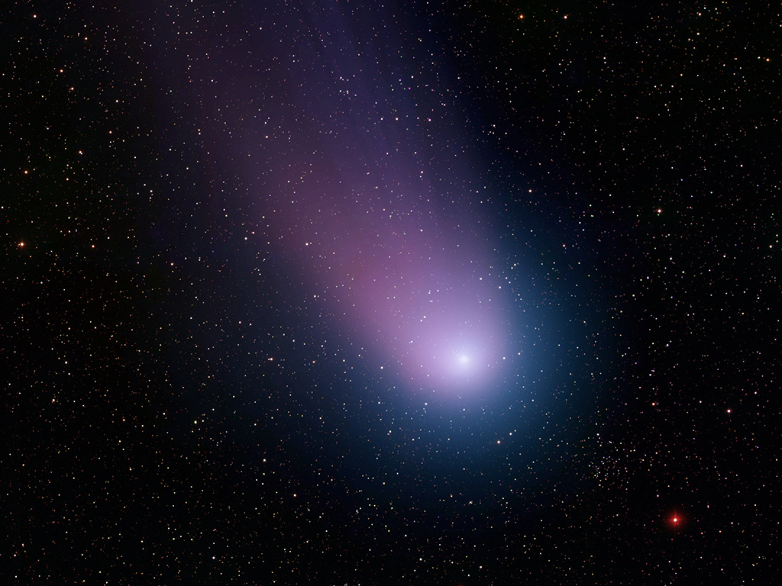
Cometas O que são, de onde vem, para onde vão
João Paulo Monteiro Cruvinel da Costa – Centro de Divulgação da Astronomia – Universidade de São Paulo
Notes:
Icy Comet NEAT
T. Rector (University of Alaska Anchorage), Z. Levay and L.Frattare (Space Telescope Science Institute) and National Optical Astronomy Observatory/Associat ion of Universities for Research in Astronomy/National Science Foundation
http://nasaimages.org/luna/servlet/detail/nasaNAS~20~20~120602~227304:Icy-Comet-NEAT

Slide 2
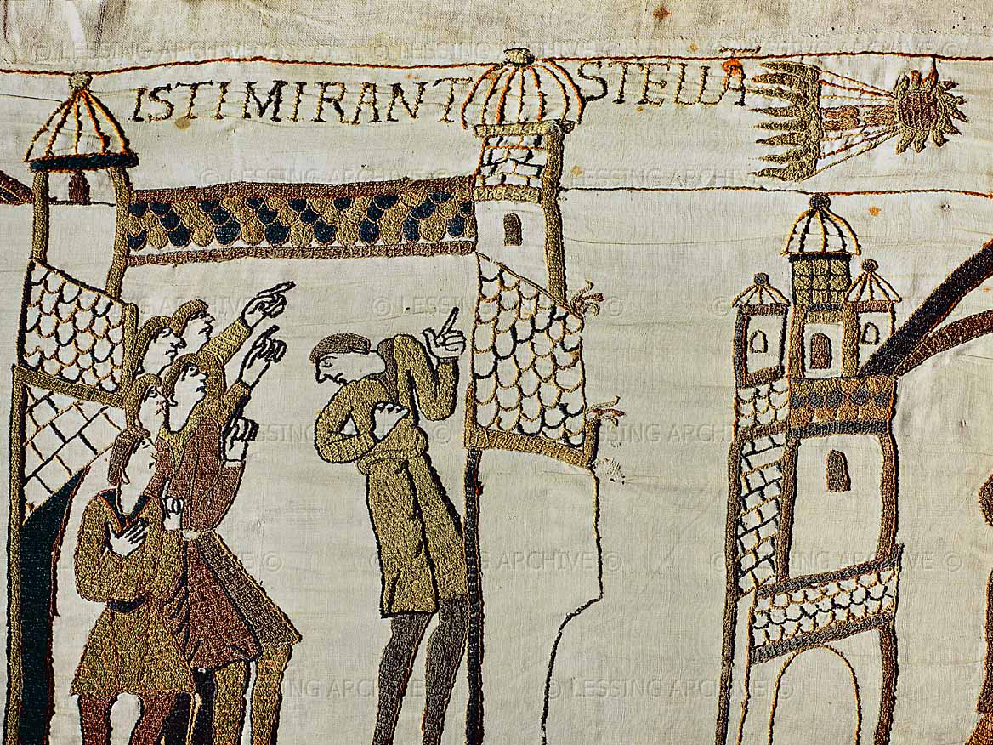
Notes:
Bayeux Tapestry
Erich Lessing Culture and Fine Arts Archive
http://www.lessing-photo.com/dispimg.asp?i=31010122+&cr=38&cl=1

Slide 3
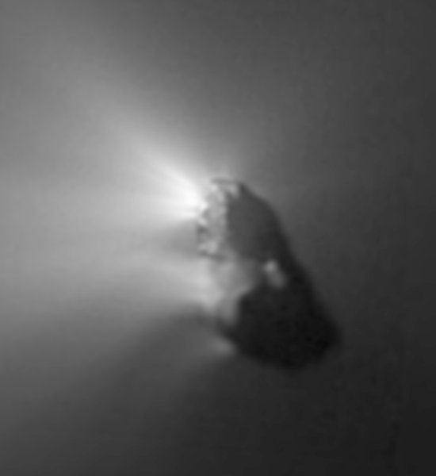
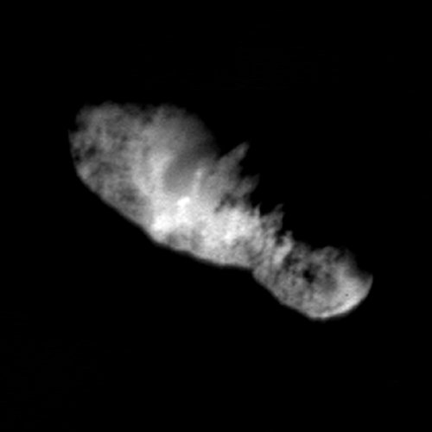
Notes:
Halley's Nucleus
Halley Multicolor Camera Team [http://www.linmpi.m…], Giotto Project [http://sci.esa.int/…], ESA [http://www.esrin.es…]
http://www.nasaimages.org/luna/servlet/detail/NVA2~4~4~4024~104550:Halley-s-Nucleus--An-Orbiting-Icebe#
Comet Wild 2's Heart
NASA
http://www.nasaimages.org/luna/servlet/detail/nasaNAS~20~20~120914~227616?qvq=q:comet+nucleus
Comet Borrelly's Nucleus
Deep Space 1 Team [http://nmp.jpl.nasa…], JPL [http://www.jpl.nasa…], NASA [http://www.nasa.gov/]
http://www.nasaimages.org/luna/servlet/detail/NVA2~4~4~4408~104934:Comet-Borrelly-s-Nucleus#

Slide 4
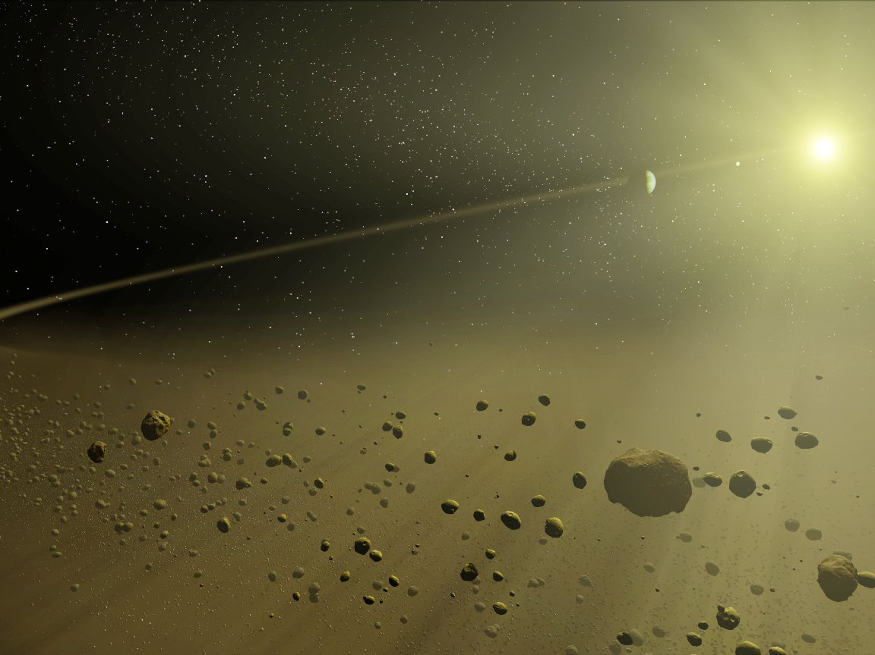
Notes:
A Distant Solar System
NASA/JPL-Caltech/T. Pyle (SSC)
http://www.nasaimages.org/luna/servlet/detail/nasaNAS~12~12~64243~168680:A-Distant-Solar-System#

Slide 5
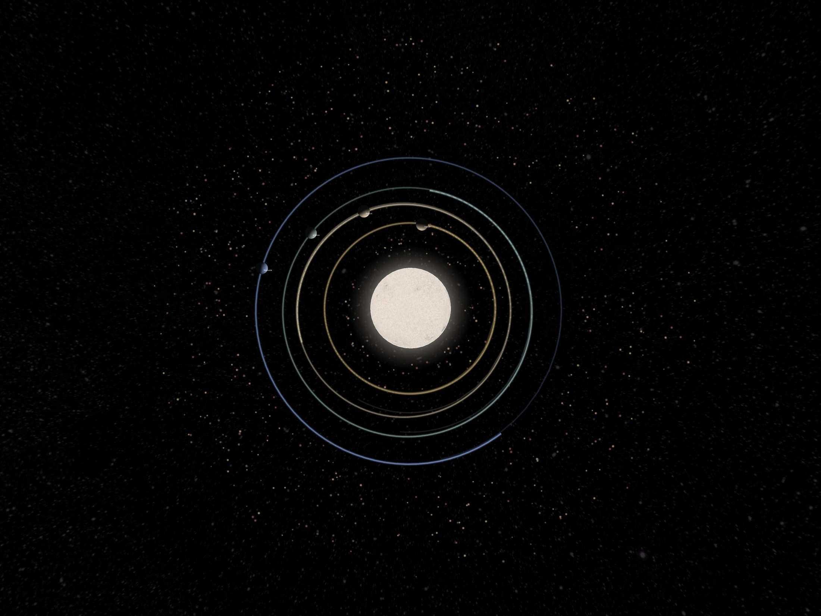

Slide 6
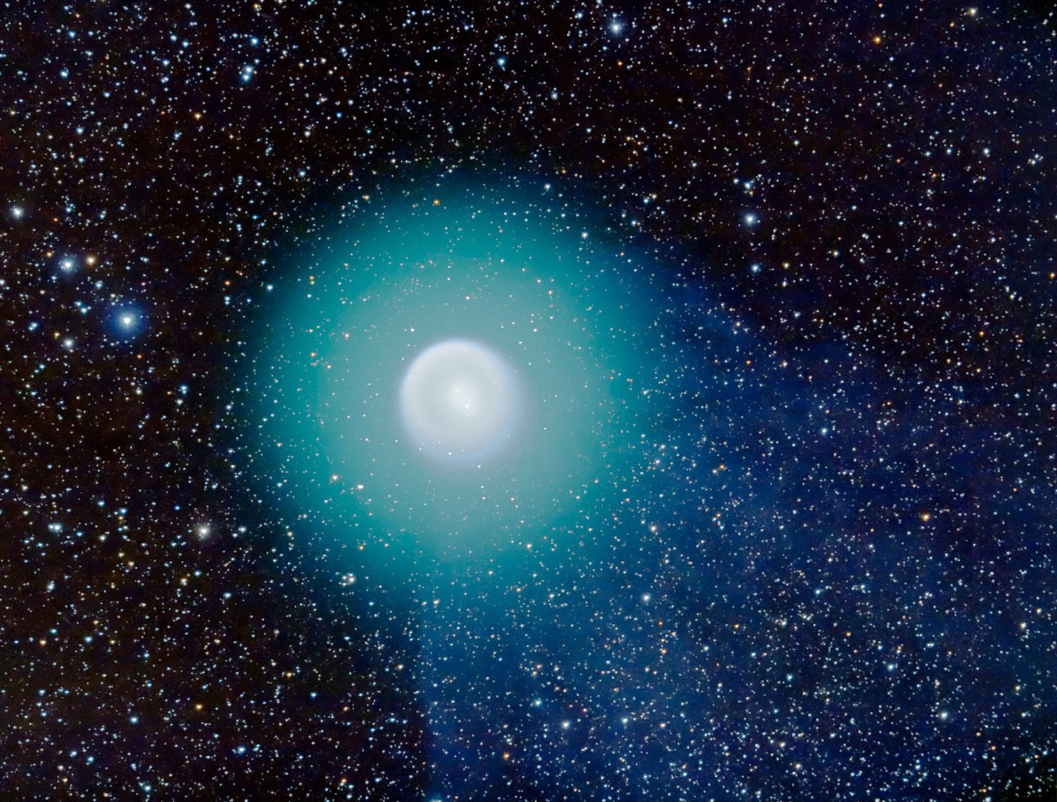
Notes:
Hubble Zooms In on Heart of Mystery Comet
NASA [http://www.nasa.gov/], ESA [http://www.spacetel…], and A. Dyer
http://www.nasaimages.org/luna/servlet/detail/NVA2~8~8~14618~115159:Hubble-Zooms-In-on-Heart-of-Mystery#

Slide 7
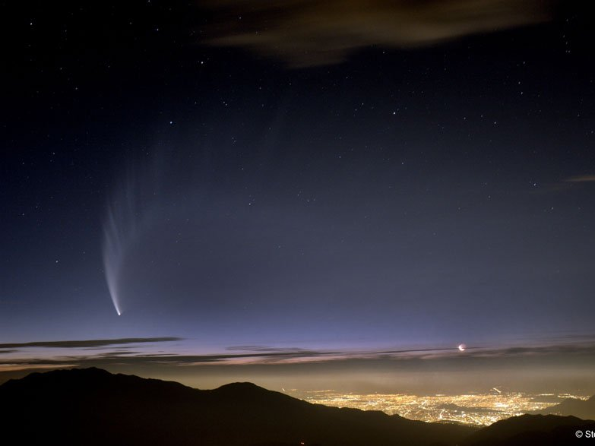
Notes:
Comet McNaught Over Chile
Stéphane Guisard [http://www.astrosur…]
http://www.nasaimages.org/luna/servlet/detail/NVA2~4~4~6585~107111:Comet-McNaught-Over-Chile#

Slide 8
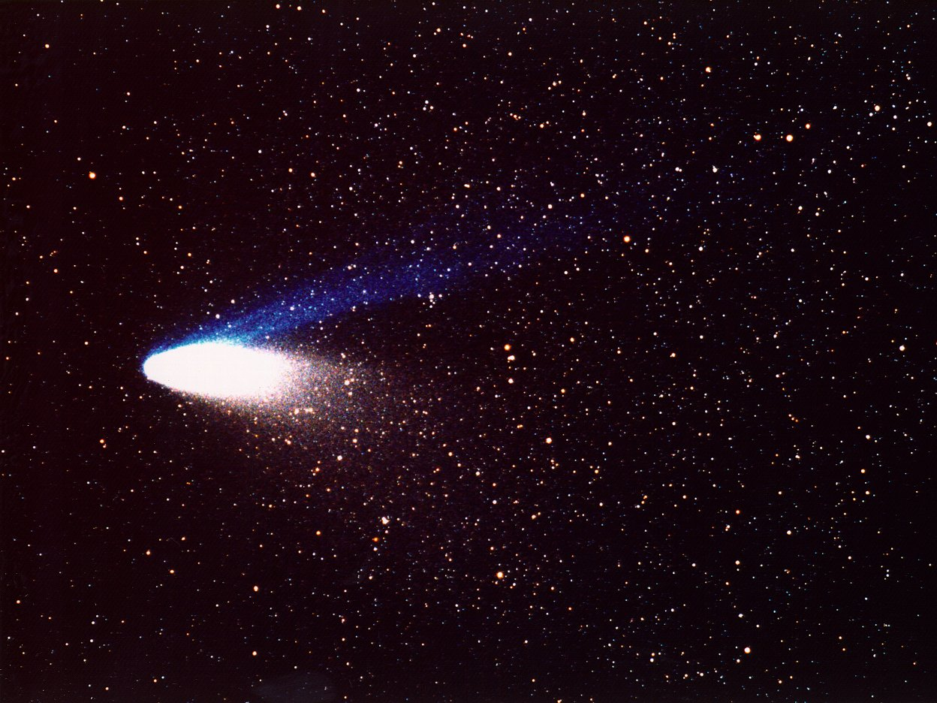
Notes:
Comet Hale-Bopp
NASA/JPL-Caltech
http://www.nasaimages.org/luna/servlet/detail/NVA2~14~14~24819~124512:Comet-Hale-Bopp#

Slide 9
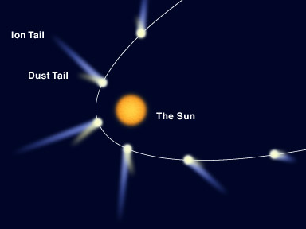
Notes:
Comet Tail
http://www.physics.hku.hk/~nature/notes/lectures/images/chap10/comet_tail.jpg

Slide 10
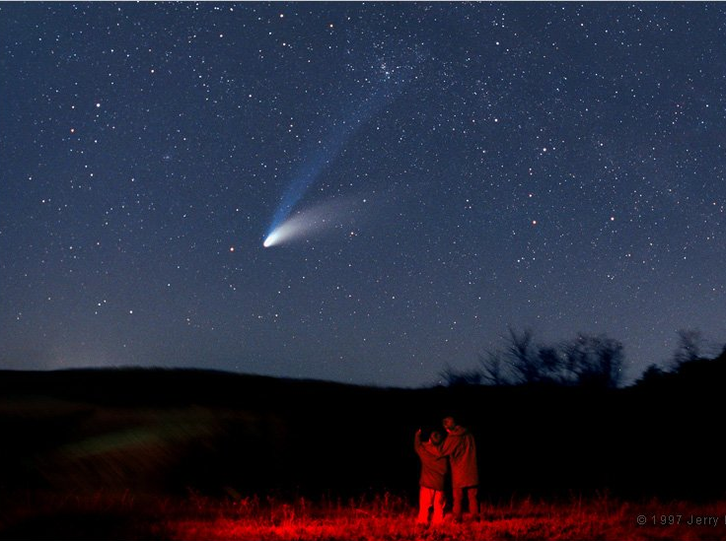
Hale-Bopp
longo período
descoberto em 1995
observado em 1997
Notes:
Hale-Bopp: The Great Comet of 1997
Jerry Lodriguss (Catching the Light [http://www.astropix…])
http://www.nasaimages.org/luna/servlet/detail/NVA2~4~4~6305~106831:Hale-Bopp--The-Great-Comet-of-1997#

Slide 11
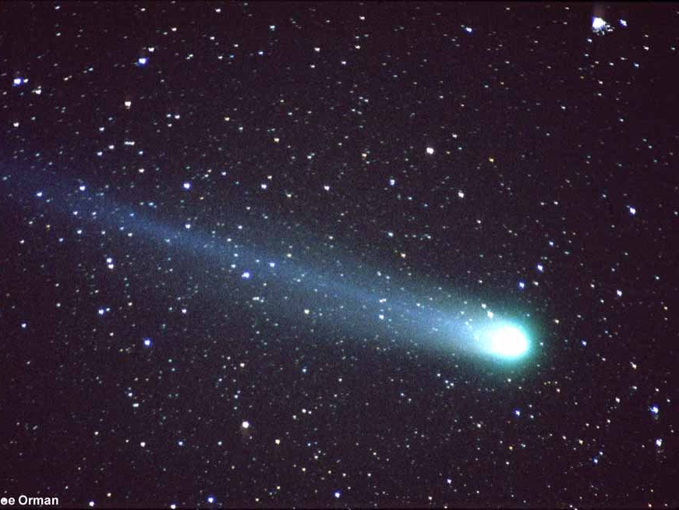
Hyakutake
longo período
descoberto em 1996
observado em 1996
Notes:
Hyakutake: Stars Through A Comet's Tail
R. Scott [ mailto:rmscott@home. com ] and J. Orman
http://www.nasaimages.org/luna/servlet/detail/NVA2~4~4~7583~108109:Hyakutake--Stars-Through-A-Comet-s-#

Slide 12
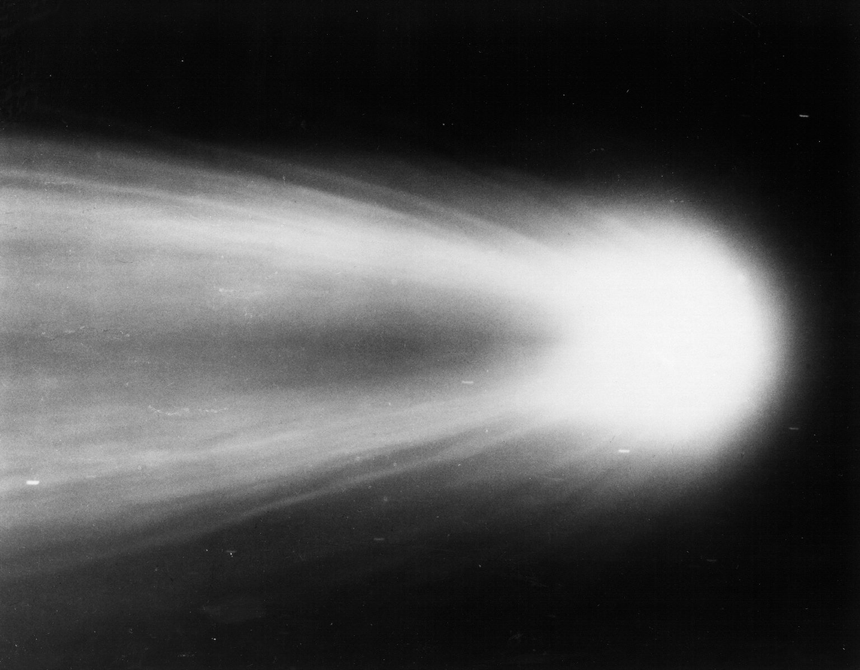
Halley
médio período ~ 76 anos
Notes:
Halley - 1910
Dr. G.W. Ritchey
http://www.nasaimages.org/luna/servlet/detail/NVA2~14~14~35817~124222#

Slide 13
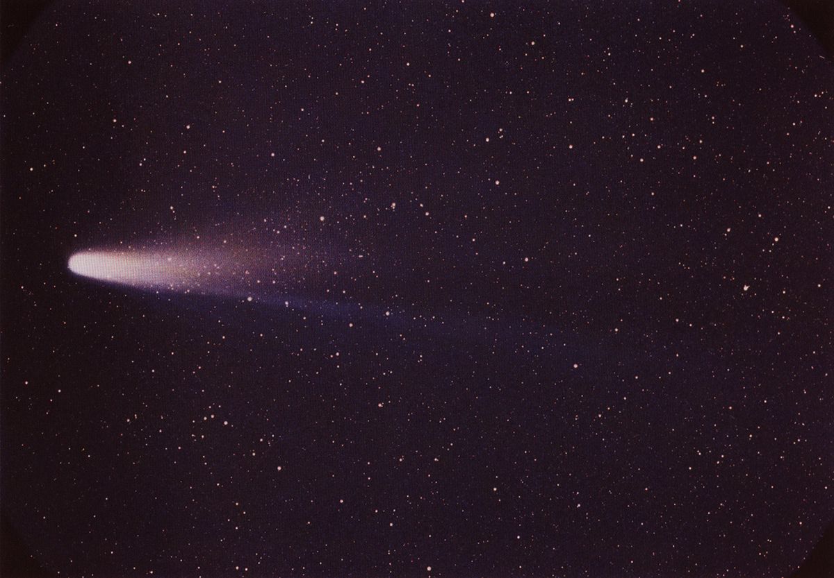
Notes:
Halley – 1986
NASA/National Space Science Data Center
http://www.britannica.com/EBchecked/topic/252831/Halleys-Comet

Slide 14
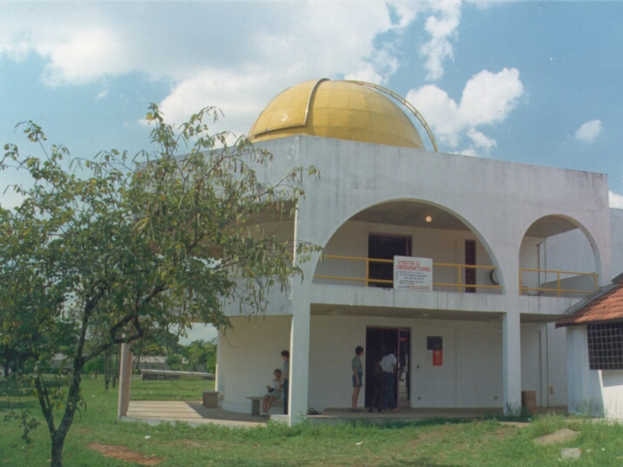
Notes:
Observatório
10 abril de 1986
http://www.cdcc.usp.br/cda/historico/index.html

Slide 15
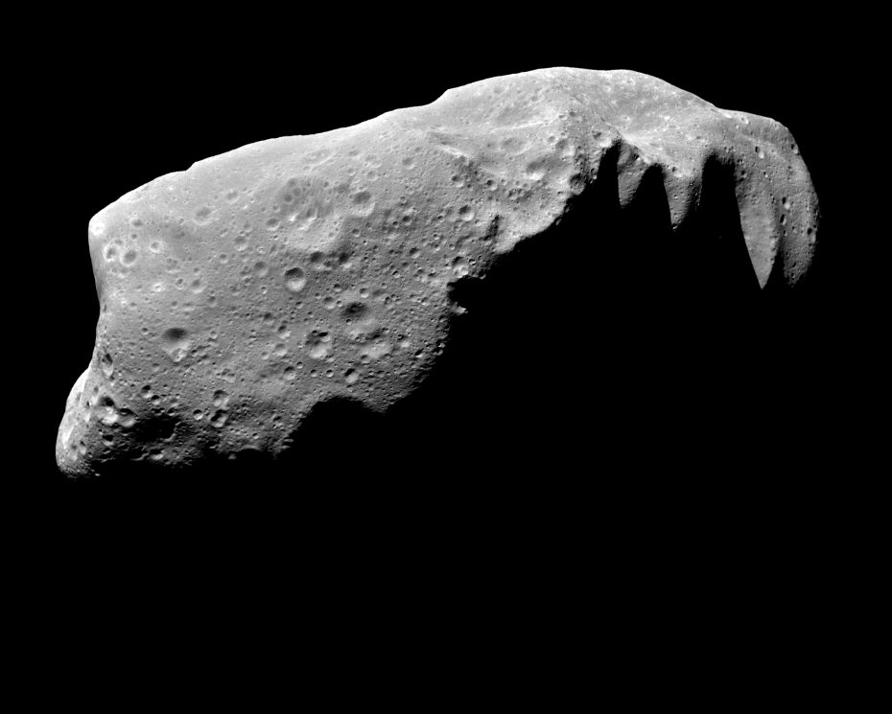
Notes:
Asteroid Ida
NASA Solarsystem Collection
http://www.nasaimages.org/luna/servlet/detail/nasaNAS~20~20~121005~227708:Asteroid-Ida

Slide 16
Notes:
Comet PShoemaker-Levy 9
NASA Hubble Space Telescope Collection
http://www.nasaimages.org/luna/servlet/detail/NVA2~8~8~12242~112783:Photo-Illustration-of-Comet-P-Shoem

Slide 17
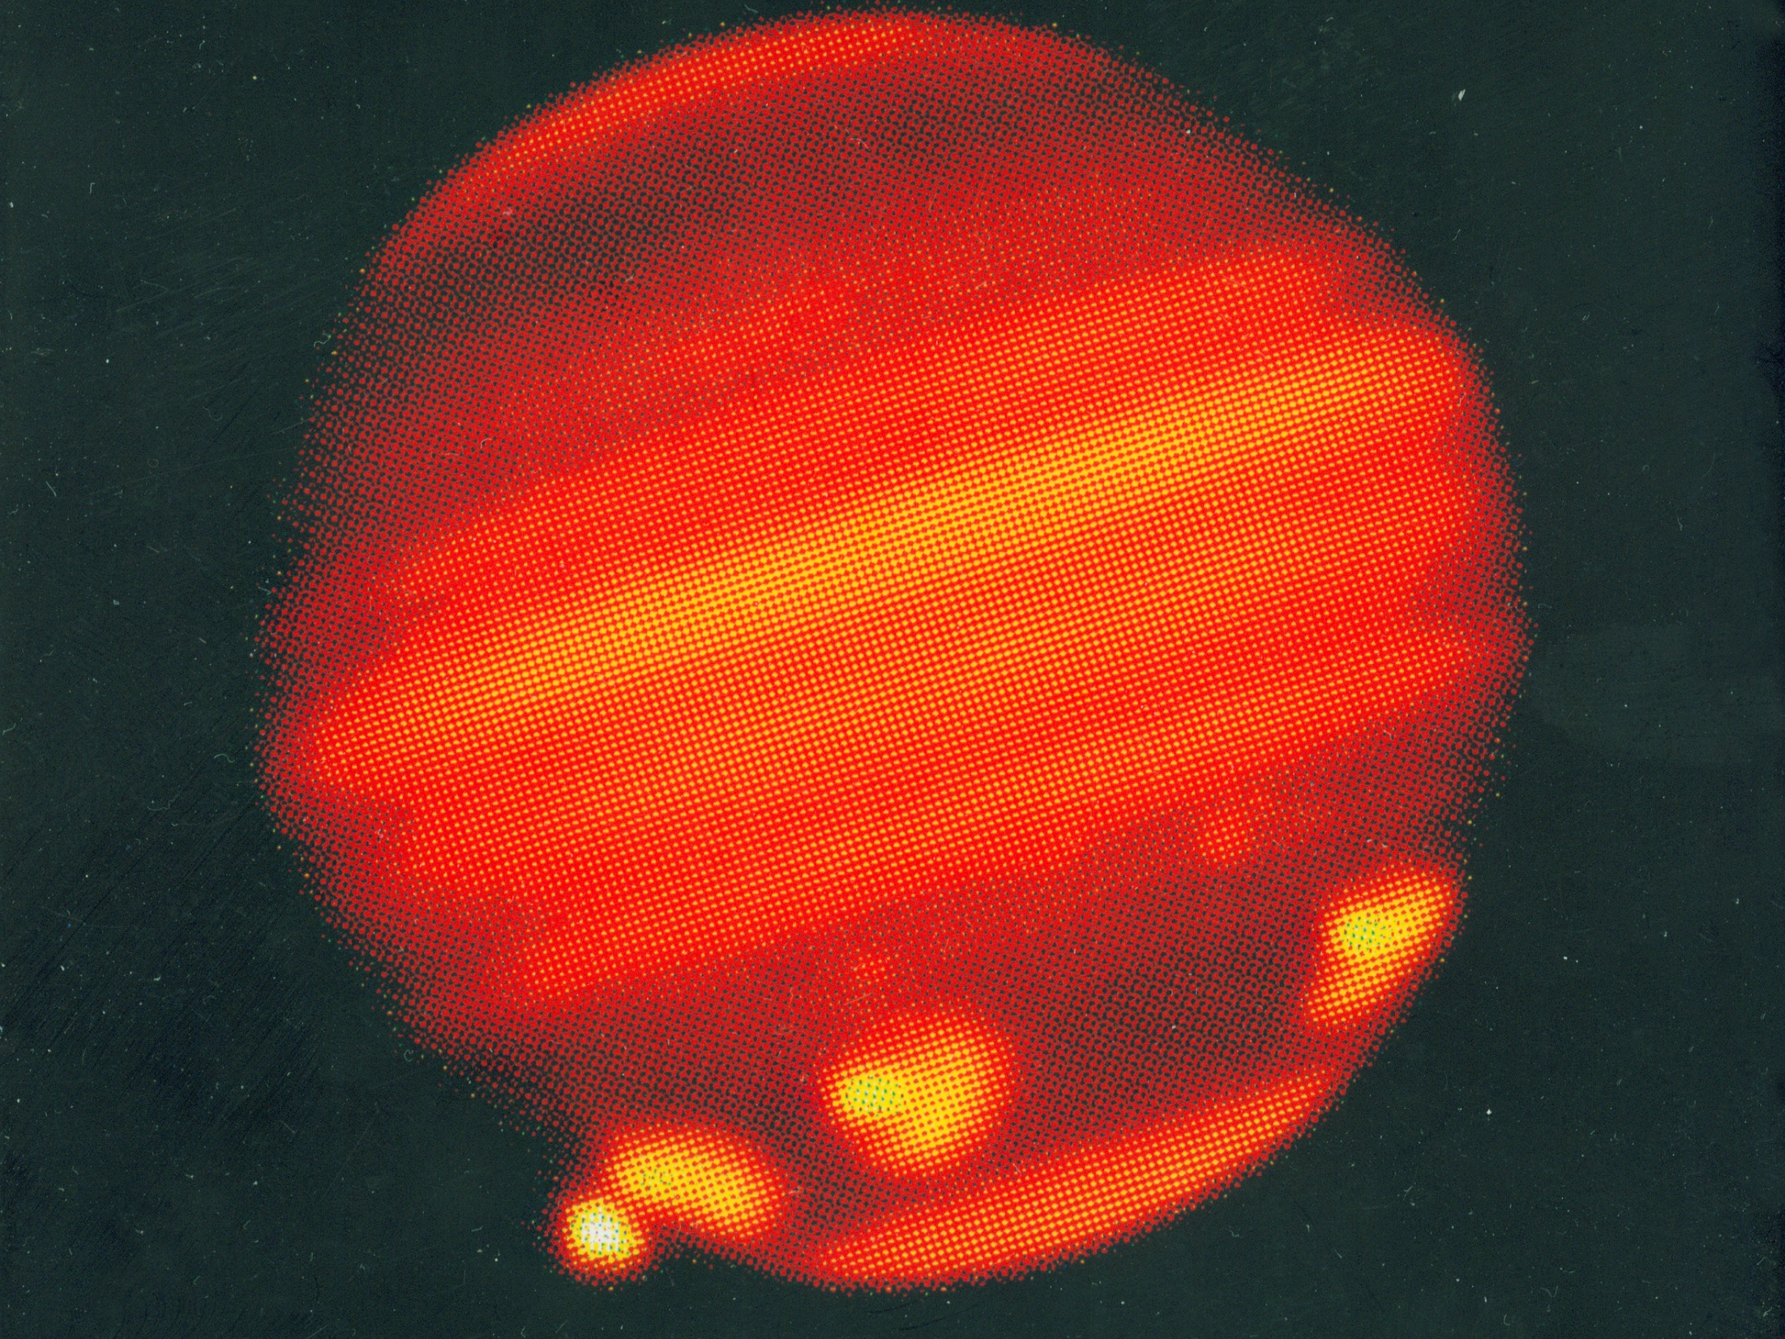
Notes:
http://www.mpia.de/Public/Aktuelles/PR/2004/PR041116/abb6.jpg

Slide 18
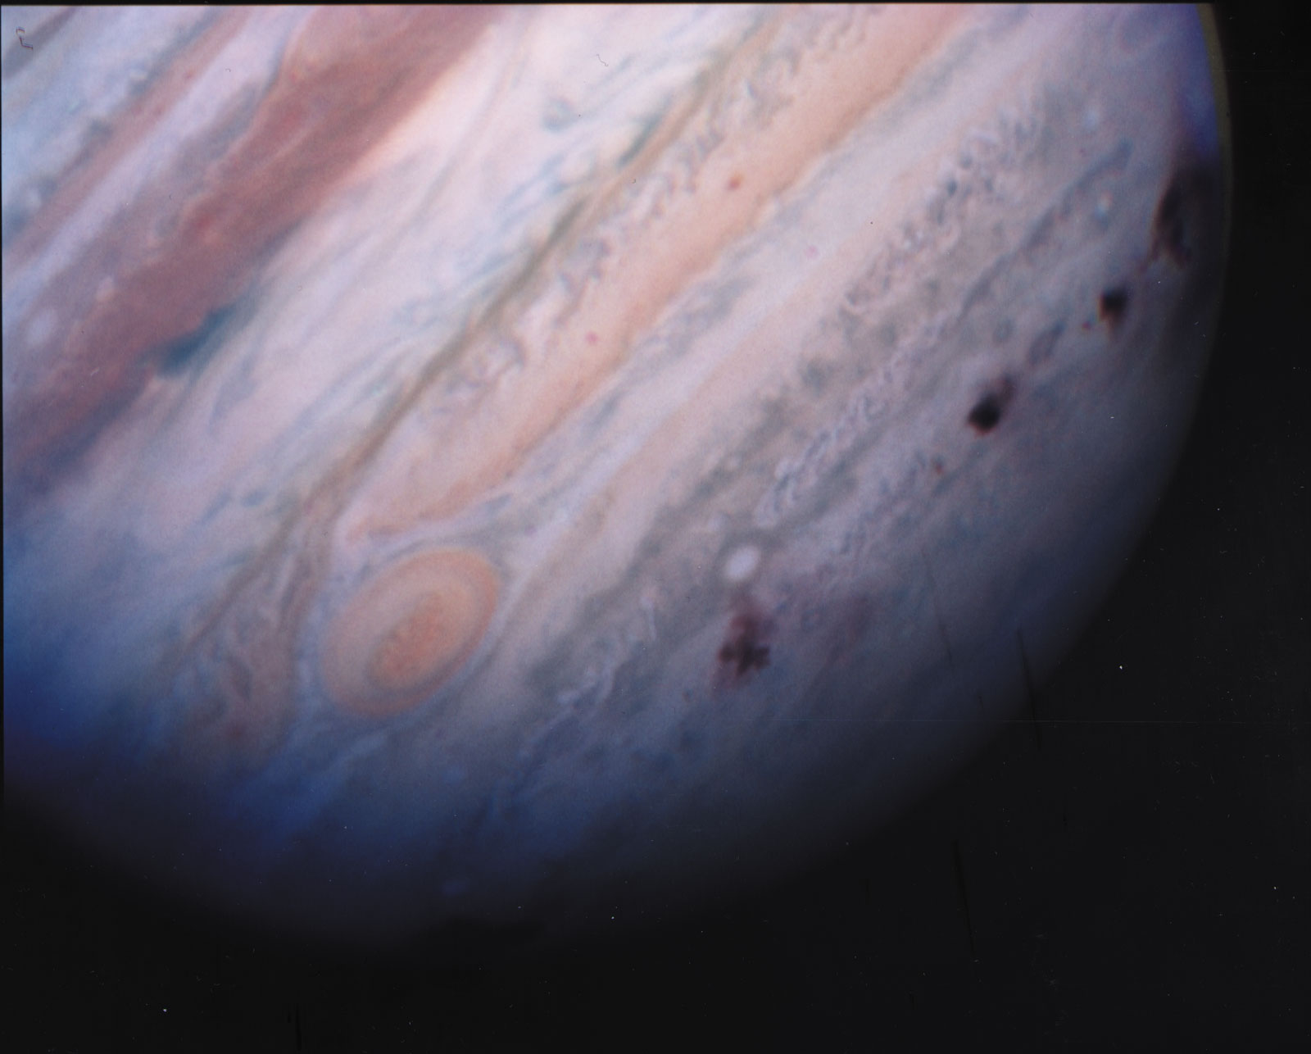
Notes:
NASA/Hubble Space Telescope Comet Team
http://www.britannica.com/bps/media-view/71541/1/0/0

Slide 19
?

Slide 20
João Paulo Monteiro Cruvinel da Costa
joao.monteiro.costa@usp.br

